Slide 1
Statics of Rigid Bodies
Chapter 5

Slide 2
Chapter Objectives
find the sum of moments of the forces acting on a rigid body
solve problems about the equilibrium of a rigid body

Slide 3
back in the good old days of M1 you learnt to do this!

Slide 5
5.1 You can calculate the moment of a force acting on a body

Slide 6
5.2

Slide 8
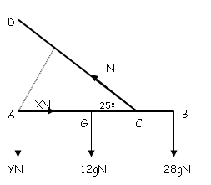
A uniform rod AB of mass 12 kg and length 15 m is smoothly hinged at A and has a particle of mass 28 kg attached to it at B. A light inextensible string is attached to the rod at the point C where AC = 9m and to the point D vertically above A, keeping the rod in a horizontal position. The tension in the string is TN. If the angle between the rod and the string is 25°, calculate, in terms of T, the resultant moment about A of the forces acting on the rod.

Slide 15
One of the fundamental ideas to remember with this type of problem is that surds must be used until the final calculation.

Slide 16
This particular problem can also be solved using the techniques in
5.3 Triangle of Forces

Slide 17
the yellow writing on page 139 explains the principle behind this

Slide 18
the vertical distance from the rod to the mass can be expressed two ways:
(8 - x) tan 45 and x tan 60
so
(8 - x) tan 45 = x tan 60
8 - x= x tan 60
x(tan60 + 1) = 8
x = 2.93 m

Slide 19
since the rod is in equilibrium the vector sum of the three forces acting must be zero, so you can draw a triangle of forces
using the sine rule gives:
T₁ = 12g sin30 ÷ sin 105 = 60.87N
T₂ = 12gsin45 ÷ sin 105 = 86.09N
45°
T₁
12g
105°
30°
T₂
the most exciting part here is working out which angle is which!

Slide 20
5.4 Solve problems about rigid bodies resting in limiting equilibrium

Slide 21
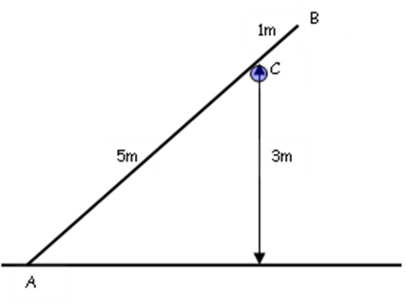

Slide 25
Problems Involving ladders
Ladders will either be lent against a wall or horizontal. We sometimes have to consider frictional forces on the ladder due to the floor or wall (ladder is in contact with a 'rough' surface). Remember that the friction F acts parallel to the surface in such a direction as to oppose the motion.

Slide 32
taking moments about Q

Slide 33
