Slide 1
24/06/2014
Objective: to be able to create a rangoli pattern.
Skills: Distilling and Imagining
By the end of the lesson:
All: Will be able complete a rangoli pattern
Most: will be able to colour their rangoli pattern
Some: will be create more than one rangoli pattern

Slide 2
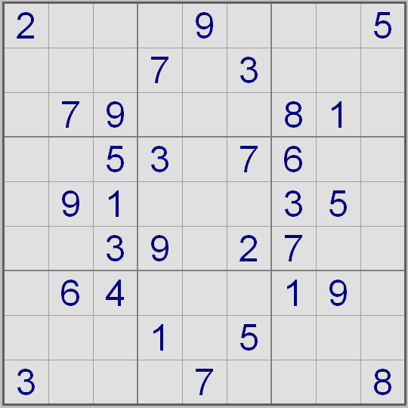
Starter

Slide 3
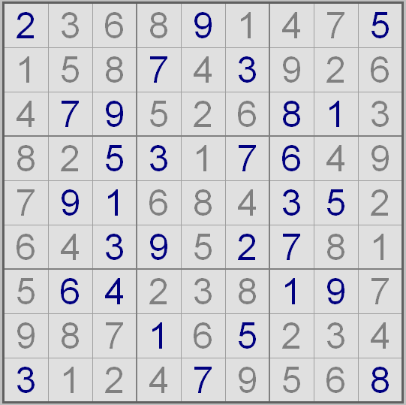
solution

Slide 4
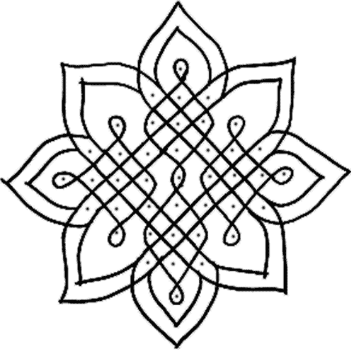
Rangoli Pattern
Do you know what they are?
Do you know what they are used for?

Slide 5
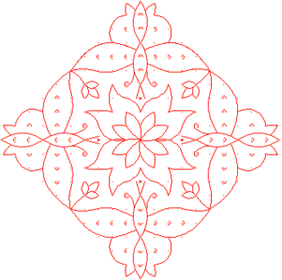
Rangoli Pattern
A Rangoli is a colourful design drawn on or near the entrance to a house to welcome guests.

Slide 6
Rangoli Pattern
During Diwali, Hindus draw bright Rangoli patterns on the floor by the front door to encourage the goddess Lakshmi to enter their homes.

Slide 7
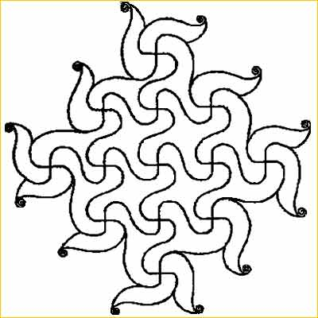
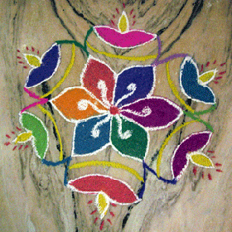
Rangoli Patterns

Slide 8
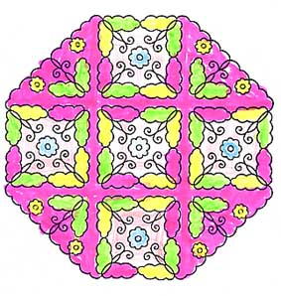
Rangoli come in all shapes and sizes!

Slide 9
Rangoli Patterns
Draw a 10 x 10 grid on dotted paper. This will use 11 dots on each of the sides.

Slide 10
Rangoli Patterns
Split the square into quarters.

Slide 11
Rangoli Patterns
Start drawing a pattern in the top left quarter.
You can make it as
easy or as hard as
you like.

Slide 12
Rangoli Patterns
Reflect the pattern into the quarter next to the filled quarter.

Slide 13
Rangoli Patterns
Reflect the pattern to fill the final 2 quarters.
Colour it in.

Slide 14
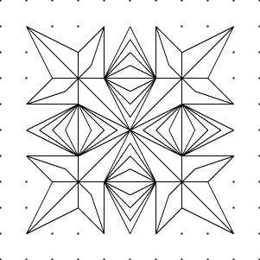
Rangoli Pattern
This is what we are going to be making today.
This is quite a tricky one to make.
You are going to design your own.

Slide 15
Rangoli Pattern

