Slide 1
Statistics Level 3
introduction

Slide 2
The Course
4 internal Assessment Standards 4 credits each
2 external Assessment standards 4 credits each
Access to www.statslc.com

Slide 3
Assessment Standards
Standard |  |  | Credits | When
91580 | 3.8 | Time Series | 4 | Term 1
91581 | 3.9 | Bivariate data | 4 | Term 1
91582 | 3.10 | Formal Inference | 4 | Term 2
91583 | 3.11 | Experimental design | 4 | Term 2
91585 | 3.13 | Probability Concepts | 4 external | Term 3
91586 | 3.14 | Probability Distributions | 4 external | Term 3

Slide 4
How to achieve or better!
Achieved | Merit | Excellence
The student has investigated time series data. They have shown evidence of using each component of the statistical enquiry cycle to investigate | The student investigated time series data, with justification. They have shown evidence of linking components of the statistical enquiry cycle to the context, and referring to evidence such as statistics, data values, trends, or features of visual displays in support of statements made. | The student investigated time series data, with statistical insight. They have shown evidence of integrating statistical and contextual knowledge throughout the statistical enquiry cycle. They may have reflected on the process, considered other relevant variables, evaluated the adequacy of any models, or shown a deeper understanding of models.

Slide 5
The Statistics Enquiry Cycle
PPDAC
Problem
Plan
Data
Analysis
Conclusion

Slide 6
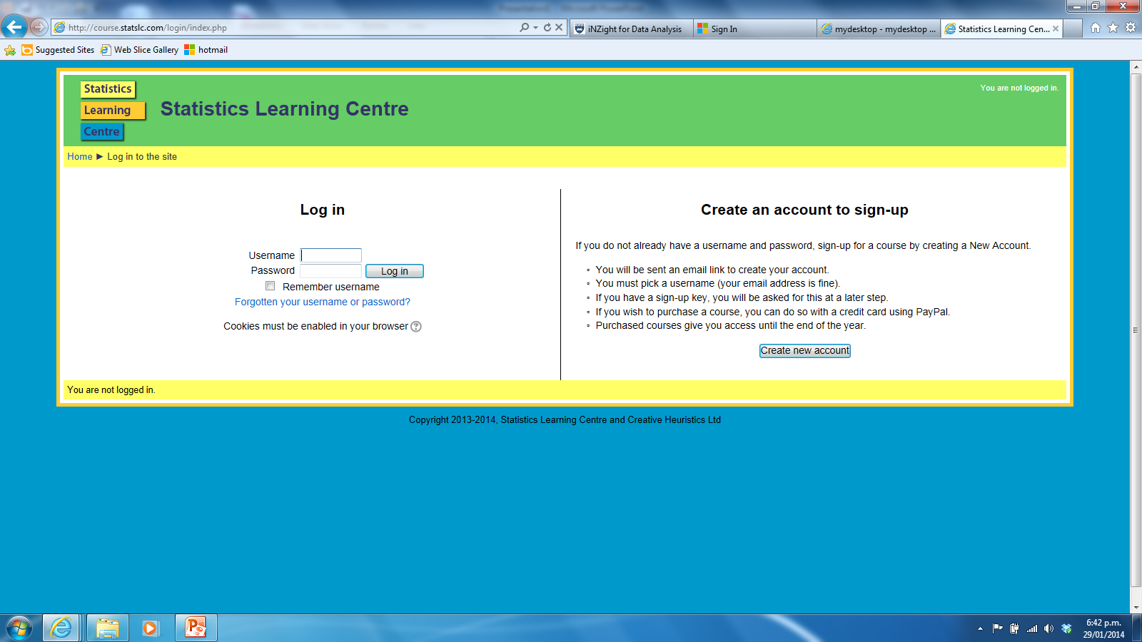
Statistics Learning Centre

Slide 7
Using Technology

Slide 8
Using your calculator to find summary statistics.
Select 2 from the menu to get STAT.
Delete any existing data by pressing F6 F4 F1 {(more) DEL_A YES] and repeat if required
Move the cursor to column one and enter the data values.
12, 15, 21, 14, 13, 12, 11, 24, 19, 17, 18, 17, 21, 12,
Select F2 F6 (CALC, SET) and check that 1Var Xlist: list1 and 1Var Freq: 1
Then press EXE F1
Scrolling down what summary statistics have you been given?

Slide 9
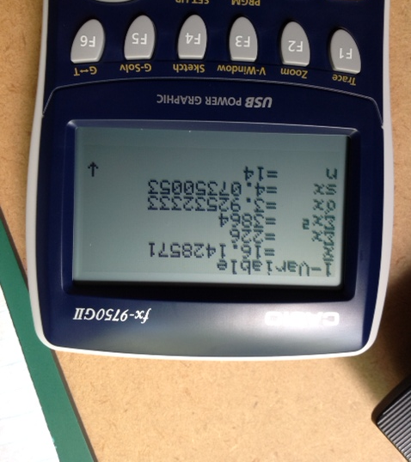

Slide 10
Using your calculator to find summary statistics from a frequency table.
Select 2 from the menu to get STAT.
Delete any existing data by pressing F6 F4 F1 {(more) DEL_A YES] and repeat if required
Move the cursor to column one and enter the data values for Bullseyes.
Bullseyes | frequency
0 | 2
1 | 3
2 | 4
3 | 7
4 | 6
5 | 3
total | 35

Slide 11
Using your calculator to find summary statistics from a frequency table.
Move the cursor to column two and enter the frequency.
Select F2 F6 (CALC, SET) and check that 1Var Xlist: list1 and 1Var Freq: 1
Then press EXE F1
Scrolling down what summary statistics have you been given?
Bullseyes | frequency
0 | 2
1 | 3
2 | 4
3 | 7
4 | 6
5 | 3
total | 35

Slide 12
Using your calculator to find summary statistics from a frequency table.
Bullseyes | frequency
0 | 2
1 | 3
2 | 4
3 | 7
4 | 6
5 | 3
total | 35
Select F2 F6 (CALC, SET) and check that 1Var Xlist: list1 and 1Var Freq: list2
Then press EXE F1
Scrolling down what summary statistics have you been given?

Slide 13
A bit of practice on this now!

