Slide 1
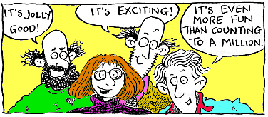
Statistics Time Series
Making Predictions

Slide 2
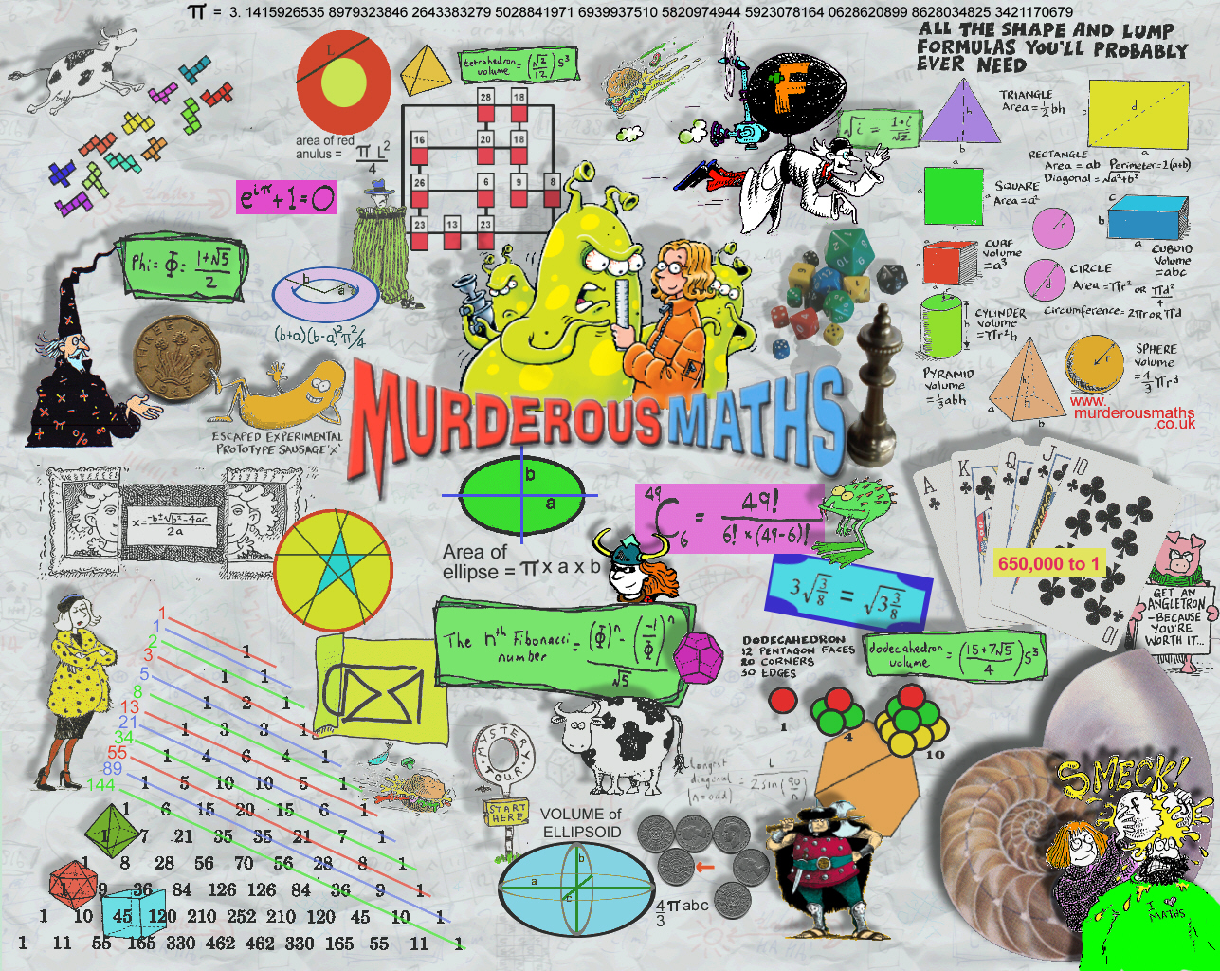

Slide 3
(Achieve) Making and discussing predictions (estimates) of the next two cycles of data Explain a couple of predictions eg Jan 2012 tourist numbers are... A prediction MUST have correct units (and things like millions) Just copying the iNZight graph and table of predictions is NOT enough, as these are not rounded and with correct units.
(Merit) Emphasise that the predictions are estimates of future data values. Discuss them in context and rounded sensibly. Discuss what the prediction error means (prediction interval)
(Excellence) How might the forecasts be used (and who might use them) - discuss. Be careful if the end of the trend line has been influenced by the position in the seasonal cycle of the end point more detail to follow This is discussion worth noting, exploring and investigating. You could also compare Excel predictions with iNZight predictions, and discuss the differences and prediction interval.

Slide 4
Holt-Winter method uses exponential smoothing - where recent data has greater weight, and old data has low weight. The weighting changes by a constant ratio (exponential decay)
Smooth's the trend, seasonal and sub-series, then puts these together and produces a prediction.
It is an Additive Model: standard trend + seasonal effect
state in your report you have used Holt-Winter additive model to make your predictions.

Slide 5
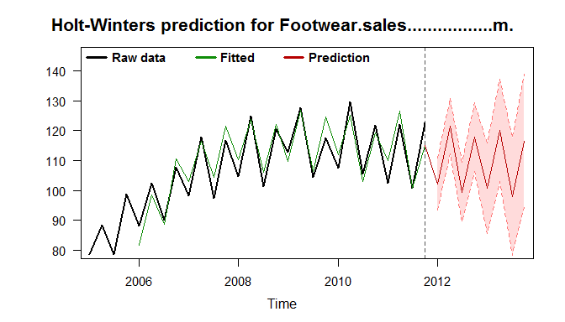
iNZight produces for you
Graph of predictions with 95% upper and lower limits for predictions (95% confidence interval for prediction interval) You are 95% confident the value will lie between the two limits
And predictions in table form
By default will give two years of predictions
fitted lower 95% bound upper 95% bound
2012 Q1 102.09952 93.40710 110.7919
2012 Q2 121.48063 112.34506 130.6162
2012 Q3 99.41817 89.39781 109.4385
2012 Q4 117.86402 106.47029 129.2577
2013 Q1 100.67345 85.44517 115.9017
2013 Q2 120.05456 102.83635 137.2728
2013 Q3 97.99210 78.40309 117.5811
2013 Q4 116.43795 94.14221 138.7337

Slide 6
First video
Youtube video to watch

Slide 7
add your predictions to 3 of your power points
This example comes from the low excellence exemplar we have used
Make sure your data is here as well!
Using the holt-winters model for calculating forecasts I estimate that the total amount of money spent on food in Supermarket and Grocery in NZ in Q4 2010 is 2770 million dollars but could be between $2666 and $2867 million dollar, for Q4 2011 the total amount spent is predicted to be $2810 million dollars but could be between $2614 and $3008 million dollars.
Using such a model to make forecasts assumes that the seasonal pattern of total amount of money spent in Supermarket and Grocery in NZ is reasonable constant and not too varied. The fitted model fits the data fairly well (apart from just after 2004 and 2008) and the seasonal effects have remained relatively constant but with some small variation in the first and last quarters. Therefore I am reasonably confident that my forecasts are accurate.

Slide 8
other stuff I came across when doing my research

Slide 9
a whole bunch of videos on Youtube
Trend
Seasonal Variation
Time Series residuals
Excellence Predictions
Excellence Research

Slide 10
seasonal variation
fluctuations that repeat themselves within a fixed period of a year.

Slide 11
cyclical component
pattern repeated over time periods of differing lengths, usually longer than one year
example: business cycles

Slide 12
The essential difference between the seasonal and cyclical components is that seasonal effects occur at regular, predictable intervals, whereas the timing of cyclical effects is less predictable.

Slide 13
random variation
the random movement up and down of a time series after adjustment for the trend, seasonal, and cyclical components
examples: natural disasters, fads

