Slide 1
Statistics Time Series
Decomposition

Slide 2
Merit
Decomposing data separates it into the Trend, Seasonal, & Residual component.
The relative influence of each of the components (as a percentage of the overall variation can be investigated.
What is the total variation of the Data? (over the time period)
What is the Trend Component (% of the total variation of the Data) What is the Seasonal Component (% of the total variation of the Data) What is the Residual Component (% of the total variation of the Data)
How do these compare?
Discussion MUST be in CONTEXT
'As a guide' a good model has the residual component of variation is less than 10% of the total variation.
Residuals - Are there any unusual observations - do they warrant further investigation.
Note: iNZight graphs do not have labels on the vertical axis. For Merit or better you will need to add a label with units on the vertical axis.

Slide 3
The purpose of the decompose function in iNZight is to enable us to identify the relative contribution of each component to the overall variation in the raw data series.
We are interested in what is causing the variation in the raw data series.
Is it the seasonal component?
Is it the trend?
is it some other residual factor?

Slide 4
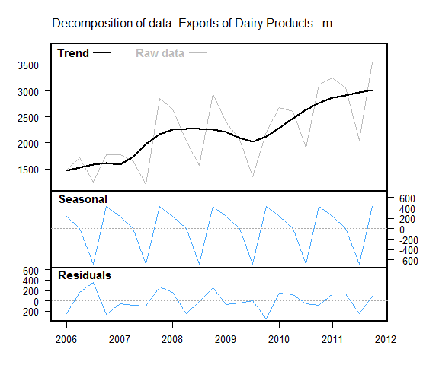
Long term trend – Looking at the decomposed series I can see from the raw data that the peak is about $3500 million in dairy exports and the low is $1300 million. This gives a variation of $2200 million over the six year period.
The trend is clearly an increasing one from a low of $1500in 2006 to one of $3000 million by the end of 2011, an increase of about $250 million per year. In 2009 exports of dairy dropped slightly , perhaps reflecting the onset of the global economic recession (add reference here), but then resumed their upward trend.

Slide 5
Looking at seasonal component of the time series I can see it goes from -$650 million to $400 million which gives a total seasonal variation of $1050 million. For dairy exports the low occur in July to September each year (-$650 million during the winter months) and the high in October to December ($400 million during the Spring).

Slide 6
There is some residual activity in the series.
Residuals have a range of $750 million ($400 million to -$350 million), but most residuals lie within the range ±$200 million. two residuals that fall outside this range are when exports dropped at the end of 2006 and 2009. These residual activities could be such things as the exchange rate; the lower the value of the NZ dollar the more attractive in terms of price our goods are to overseas countries, or the onset of the global economic recession, or the drought (try and find a web site to support your idea).
The main driving force in this series however is the trend which is an increasing one.

Slide 7
on Youtube

Slide 8
from the low excellence examplar we have
Looking at the residual plot most residuals are within $50 million of the trendline. The overall range of the raw data is $884 million (maximum – minimum = 2756-1872) so a residual of $50 million is quite small in proportion to $884 million. The exception would be the unusual residuals from Q1 2004 which is right on the $50 million mark and Q1 2008 which is about $75 million above the trendline. There is also a bit of a difference between the raw and fitted data for these times looking at the holt-winters plot.
Below is a comparison of the actual data values and predicted values for the last three consecutive quarters of the recorded data. To calculate the predictions, the model was refitted and the predictions re-calculated with the last three data points removed.
Date Actual data Prediction Lower Limit Upper Limit
Q1 2010, $2526 $2595 $2493 $2697
Q2 2010 $2468 $2488. $2362 $2615
Q3 2010 $2471 $2505 $2356 $2654
All actual data values (which are in millions of dollars, rounded to the nearest dollar) are in the prediction intervals which means that the fitted model is a good fit and we can rely on the forecasts produced.

Slide 9
Now add comments on the residual component to 3 of your time series power points.

