Slide 1
Trig Identities and Formulae
AS 91575
4 credits

Slide 2
inverse trig functions

Slide 3
Inverse Trig Functions
Learning objectives
I can recognise and evaluate an inverse trig function

Slide 4
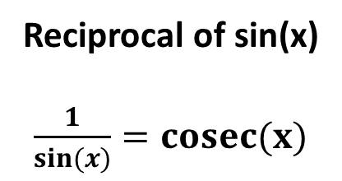
Inverse of sin(x)
$sin−1(x)$
if y = $sin−1(x)$
(read as inverse sin(x))
x = sin(y)
$sin−1(x)$ also written arc sin (x)
Reciprocal of sin(x)
$\frac{1}{sin(x)}=cosec(x)$

Slide 5
find $sin−1\left(0.707\right) in radians and degrees$
It’s ok all we need to do is use a calculator in radians and then degrees
HINT

Slide 6
graphs of
inverse trig functions

Slide 7
Graphs of
Inverse Trig Functions
Learning objectives
I can recognise the graphs of inverse trig functions
I am aware of the term relations in this context

Slide 8
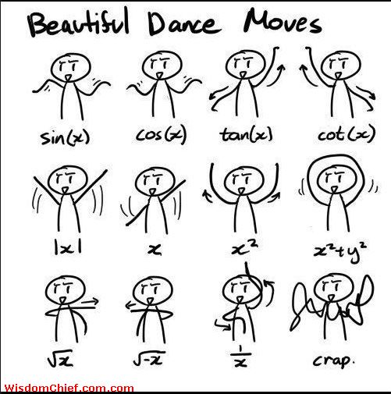
oh dear me

Slide 9
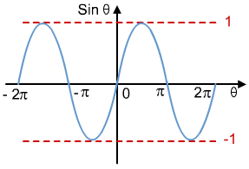
The greatest value of the sine wave is called the amplitude.

Slide 11
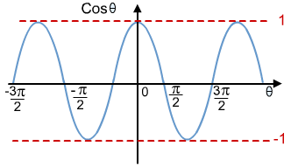
called a phase shift.

Slide 12
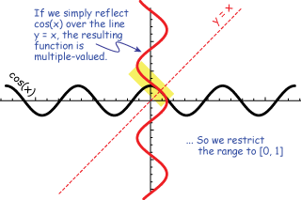

Slide 13
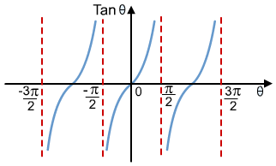
It has a period of π.

Slide 14
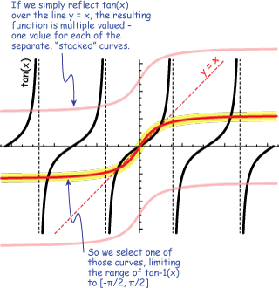

Slide 15
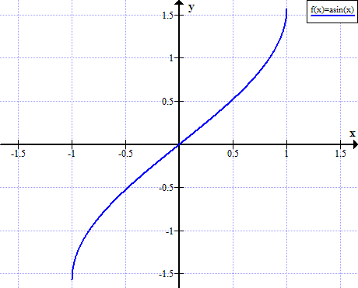
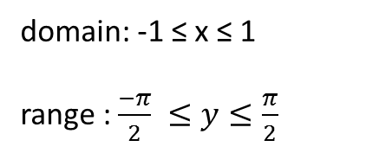
so now you’ve seen the complicated version here are the easier versions ☺
domain: -1 ≤ x ≤ 1
range : $\frac{−π}{2} ≤y≤\frac{π}{2}$

Slide 16
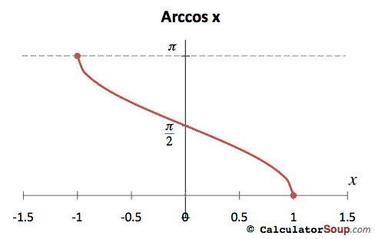
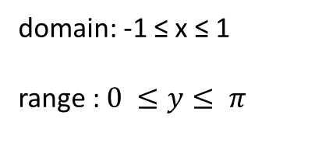
domain: -1 ≤ x ≤ 1
range : $0 ≤y≤ π$

Slide 17
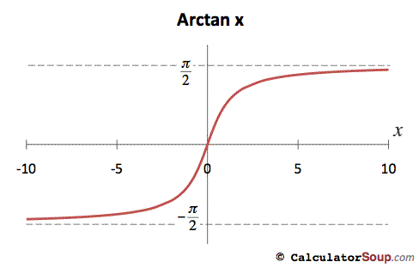
domain: $ℝ$
range : $\frac{−π}{2} ≤y≤\frac{π}{2}$

Slide 18
why do we have the easy versions?
The three inverse trig graphs are not graphs of functions because some vertical lines would cross them more than once.
We have drawn the graphs of inverse relations rather than the graphs of inverse functions
If we want to draw the graph of an inverse function we restrict the domain of the original trig function.
This means we only reflect a small portion of the graph of the original trig function in the line y = x and the result is the graph of the inverse function.

Slide 19
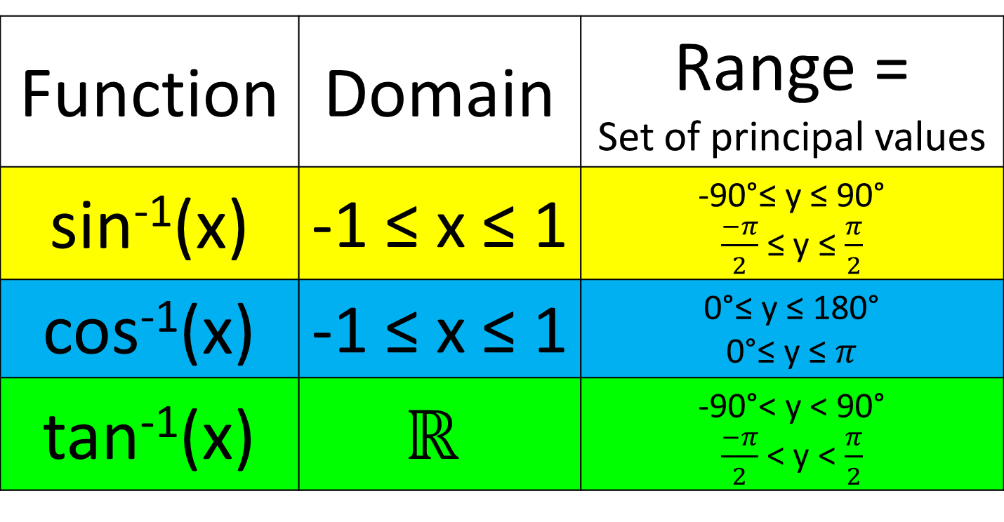
Summary of inverse trig functions
Function | Domain | Range = Set of principal values
sin⁻¹(x) | -1 ≤ x ≤ 1 | -90°≤ y ≤ 90° $\frac{−π}{2}$ ≤ y ≤ $\frac{π}{2}$
cos⁻¹(x) | -1 ≤ x ≤ 1 | 0°≤ y ≤ 180° 0°≤ y ≤ $π$
tan⁻¹(x) | $$ℝ$$ | -90°< y < 90° $\frac{−π}{2}$ < y < $\frac{π}{2}$

Slide 20
inverses for the
reciprocal trig functions

Slide 21
Inverses for the
Reciprocal Trig Functions
Learning objectives
I can calculate the inverses of reciprocal trig functions

Slide 22

what do you think sec ⁻¹(x) means?
?
if y = sec ⁻¹(x)
then x = sec(y)
$\frac{1}{x}= \frac{1}{sec⁡(y)}=\cos{(y)}$
cos(y) = $\frac{1}{x}$
y = cos⁻¹$\left(\frac{1}{x}\right)$

Slide 23
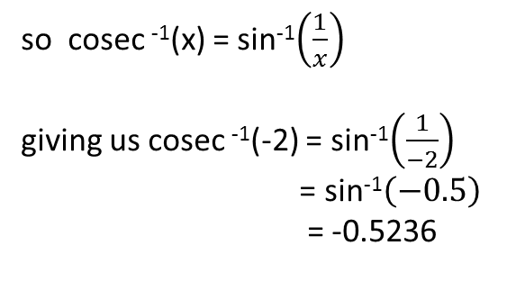
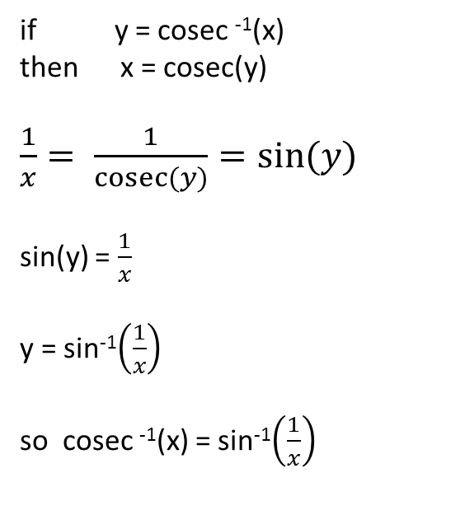
Evaluate cosec⁻¹(-2) in radians.
if y = cosec ⁻¹(x)
then x = cosec(y)
$\frac{1}{x}= \frac{1}{cosec⁡(y)}=\sin{(y)}$
sin(y) = $\frac{1}{x}$
y = sin⁻¹$\left(\frac{1}{x}\right)$
so cosec ⁻¹(x) = sin⁻¹$\left(\frac{1}{x}\right)$
so cosec ⁻¹(x) = sin⁻¹$\left(\frac{1}{x}\right)$
giving us cosec ⁻¹(-2) = sin⁻¹$\left(\frac{1}{−2}\right)$
= sin⁻¹$\left(−0.5\right)$
= -0.5236

Slide 24
Success Criteria
I can calculate the inverses of reciprocal trig functions
exercise 7.01 page 114

Slide 25
Inverse Trig Identities

Slide 26
Inverse trig identity
sin⁻¹(x) + cos⁻¹(x) = 90° $\left(=\frac{π}{2}\right)$

Slide 27
Evaluate
sin[sin⁻¹(2x)]
Evaluate
sin[cos⁻¹(3x)]
sin and sin⁻¹ are inverse functions
so
sin[sin⁻¹(2x)] = 2x
the angle who has a cosine 3x
1
$$\sqrt{1−{9x}^{2}}$$
3x
let sin⁻¹(2x) = y
then 2x = sin(y)
the question asks for
sin[sin⁻¹(2x)] = sin(y)
= 2x
so the sin of this angle is
sin[cos⁻¹(3x)] =
$$\sqrt{1−{9x}^{2}}$$

Slide 28
Success Criteria
I can calculate the inverses of reciprocal trig functions
exercise 7.02 page 115

Slide 29
Trigonometric Equations

Slide 30
Trigonometric Equations
Learning objectives
I can find the principal solution to a trig equation
I can find all the solutions to a trig equation

Slide 31
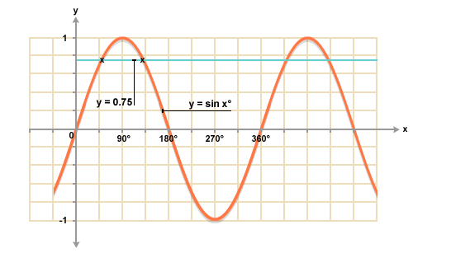
Solve sin(x) = 0.75 in degrees
the first solution is called the principal solution

Slide 32
Success Criteria
I can find the principal solution to a trig equation
I can find all the solutions to a trig equation
exercise 7.03 page 117

Slide 33
solutions involving
exact values of $π$

Slide 34
Solutions involving
exact values of $π$
Learning objectives
I can give the answer to a trig equation in terms of $π$

Slide 35
a message from your
maths teacher
It is easier to work in degrees
and then convert to radians

Slide 36
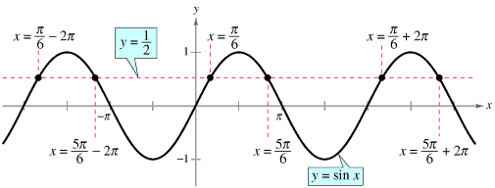
Solve sin(x) = 0.5 in radians
this gives us x = 30° which in radians is $\frac{π}{6}$
the first solution is called the principal solution

Slide 37
Solve sin(x) = -0.5 in radians
this gives us x = 210° which in radians is $\frac{7π}{6}$
the first solution is called the principal solution

Slide 38
Success Criteria
I can give the answer to a trig equation in terms of $π$
exercise 7.04 page 120

Slide 39
Multiple Solutions

Slide 40
Multiple Solutions
Learning objectives
I can find the multiple solutions to a trig equation

Slide 41
how many solution are there for sin(5x) = 0.5 between 0 and 2$π ?$
what are they?
give your answers in degrees and radians.
10 solutions

Slide 42
Success Criteria
I can find the multiple solutions to a trig equation
exercise 7.05 page 121

Slide 43
solving trig equations
by factorising

Slide 44
Solving Trig equations
by factorising
Learning objectives
I can factorise trig equations and then find the solution in degrees or radians

Slide 45
solve 2 sin²(x) + sin(x) = 0 for 0° ≤ x ≤ 360°
it’s all about factorising, can you see a common factor?
factorising gives this
sin(x)[2sin(x) + 1] = 0
one of these = 0 so deal with them separately and see what you get
1st equation
sin(x) = 0 gives
0°, 180°, 360°
2nd equation
2sin(x) + 1 = 0 gives
210 ° and 330°
final solution set
the equation has 5 solutions { 0°, 180°, 210°, 330°, 360°}

Slide 46
solve sin(x) + cos(2x) = 0 for 0° ≤ x ≤ 360°
this one’s about using trig identities. which one will you pick ?
the identity to pick
cos(2x) = 1 – 2sin²(x)
now it’s all about factorising, you need two brackets this time.
factorising gives this
[2sin(x) + 1][sin(x) – 1 ]= 0
one of these = 0 so deal with them separately and see what you get
1st equation
sin(x) - 1 = 0 gives
90°
2nd equation
2sin(x) + 1 = 0 gives
210 ° and 330°
final solution set
the equation has 3 solutions { 90°, 210°, 330°}

Slide 47
Success Criteria
I can factorise trig equations and then find the solution in degrees or radians
exercise 7.06 page 122

Slide 48
converting
sums to Products

Slide 49
Converting Sums to Products
Learning objectives
I can solve trig equations by converting sums to products

Slide 50
solve sin(4x) = sin(2x) for 0 ≤ x ≤ 2$π$
rearrange
rearrange
sin(4x) – sin(2x) = 0
convert the difference to a product
2cos(3x)sin(x) = 0
as a product
deal with each part of the equation in turn
1st equation
cos(3x) = 0 gives
30°, 90°, 150°, 210°, 270°, 330°
2nd equation
sin(x) = 0 gives
0°, 180°, 360°
final solution set
$$\left\{0, \frac{π}{6}, \frac{π}{2}, \frac{5π}{6}, π, \frac{7π}{6}, \frac{3π}{2}, \frac{11π}{6}, 2π\right\}$$
there are 9 solutions altogether

Slide 51
solve cos(3x) - cos(x) = 0 for 0° ≤ x ≤ 180°
convert the difference to a product
2sin(2x)sin(-x) = 0
-2sin(2x)sin(x) = 0
as a product
deal with each part of the equation in turn
sin(2x) = 0 gives
0°,90°, 180°
1st equation
2nd equation
sin(x) = 0 gives
0°, 180°
final solution set
there are 3 solutions altogether
$$\left\{0°, 90°, 180°\right\}$$

Slide 52
Success Criteria
I can solve trig equations by converting sums to products
exercise 7.07 page 123

Slide 53
Application of
trig functions

Slide 54
Success Criteria
I have consolidated my understanding with
exercise 7.08 page 124

Slide 55
the general solution

Slide 56
sin x = ½
solutions are x = $\frac{π}{6}$ and x = $\frac{5π}{6}$
hidden under here
every 2$π$
how often do these solutions repeat themselves?
so how do give a solution that repeats itself?
x = $\frac{π}{6}$ + 2$nπ$ and x = $\frac{5π}{6}$ + 2$nπ$
so you’ve found your first general solution ! Well done

Slide 57
2sin²(x) – sin(x) = 0
hidden under here
factorising gives sin(x) = $\frac{π}{6}$ and sin(x) = $0$
solving these gives us principal solutions of
x$=0, π, . . . . . .$
x = $\frac{π}{6}$ and x = $\frac{5π}{6}$
so how do give a solution that repeats itself?
x = n $π$ x = $\frac{π}{6}$ + 2$nπ$ and x = $\frac{5π}{6}$ + 2$nπ$
so you’ve found your second general solution ! Well done

Slide 58
2cos(3t) – 1 = 0
solve for 3t 3t = $\frac{π}{3}$ and 3t = $\frac{5π}{3}$
hidden under here
put this into a general form
3t = $\frac{π}{3}$ + 2n$π$ and 3t = $\frac{5π}{3}$ + 2n$π$
now solve for t
t = $\frac{π}{9}$ + $\frac{2}{3}$n$π$ and t = $\frac{5π}{9}$ + $\frac{2}{3}$n$π$
so you’ve found your third general solution ! Well done

Slide 59
cos(x) – sin(4x) = 0

Slide 60
sin(3x) + sin (2x) + sin(x) = 0

Slide 61
Success Criteria
I have no idea what’s happening and wish I’d stayed at home ☺

