Slide 1
Statistics Time Series
Long Term Trend

Slide 2
91580 Investigate time series data
The assessment requires multiple sessions to allow time for students to research the context and develop a purpose prior to completing the analysis.
Students need to have knowledge about the context and statements that are made need to be related to the context.
Use of a statistical graphing package is expected.
Students need to provide evidence of each component of the statistical enquiry cycle detailed in Explanatory Note 3 of the standard.
Features of the data include the trend and seasonal pattern.
While students could investigate more than one time series or combine series this is not a requirement of the standard.

Slide 4
Achieve
Produce a time series graph then discuss the Long Term Trend This MUST be quantitative - with numbers and amounts of change. It is NOT enough to say "the trend steadily increases" Discuss whether the trend is linear or not. Discuss the amount of change of the trend. Discuss the rate of change eg how much increase per month. eg: The trend increases from 9.5 million km² in 1990 to about 8.5 million km² in 2010

Slide 5
Merit
As above but the discussion is in context. eg: The average area of arctic sea ice increases from 9.5 million km² in 1990 to about 8.5 million km² in 2010. Some more detailed description - such as smaller variations in the trend line or possible reasons for the changes.

Slide 6
Excellence
Detailed thoughtful discussion: Explanation for variations in the trend line, Non-linear trend models, Piecewise models, Comparison of iNZight & Excel' Recent variation in iNZight trend line...
The trend line can vary at the ends due to where the cycle starts and finishes. To avoid this error, use the trend line values half a cycle from the ends of the raw data as estimates, rather than the end of the trend line

Slide 7
REMEMBER: there are no indication of units and scales on the vertical axis.
ADD THEM
You MUST incorporate this, eg. Sea Ice is measured in millions of km²
Discussion: Of the Long Term Trend in very general terms but in context
eg. The Arctic Sea Ice area has decreased from about 9.5 million km² in 1990 to about 8.5 million km² in 2010
In more detail: The Arctic sea ice area changes from 9.5 million km² in Jan 1990 to about 8.5 million km² in March 2011, which is a change of 1 million km² over 21 years and 3 months (which is 254 monthly increments) so the average sea ice change is about 4000 km² per month (1 000 000 ÷ 254)

Slide 8
Be Careful!!
The trend line can vary at the ends due to where the cycle starts and finishes. To avoid this error, use the trend line values half a cycle from the ends of the raw data as estimates, rather than the end of the trend line

Slide 9
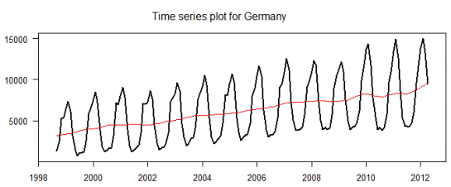
Data set ending in April 2012: Notice the trend line INCREASES
As the data ends just after a peak so the trend line increases.

Slide 10
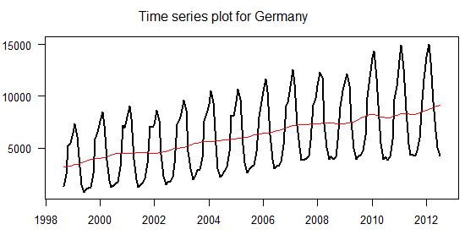
Data set ending in JULY 2012: Notice the trend line remains STEADY
As the data ends at a 'balanced point, so the trend line increases.

Slide 11
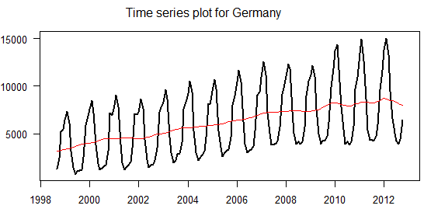
Data set ending in OCTOBER 2012: Notice the trend line DROPS
As the data ends just after a trough so the trend line drops.

Slide 12
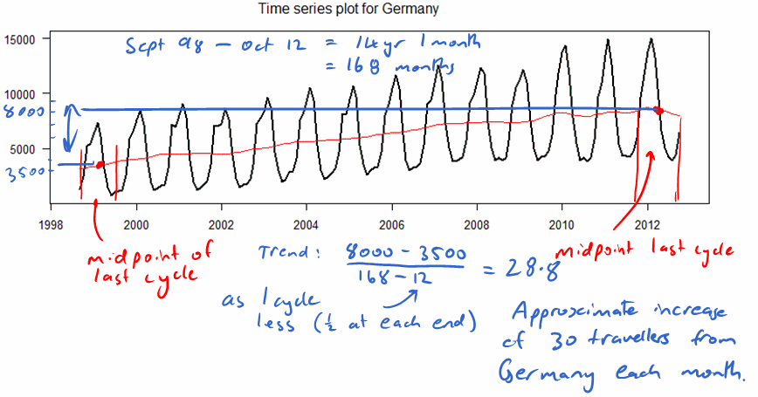
How to cater for this?
To avoid this error, use the trend line values half a cycle from the ends of the raw data as estimates, rather than the end of the trend line. Often an insignificant difference, but avoid discussing the 'possible recent downturn' which isn't there
(Excellence point)
This should be discussed if noticed in the trend line.

Slide 13
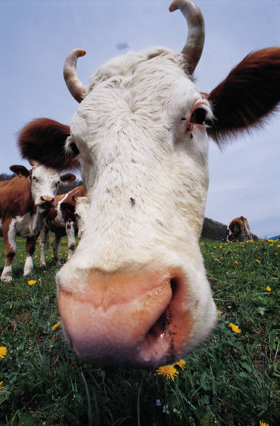
Now add the trend line comments to your Export of Dairy Products time series

Slide 14
