Slide 1
Bivariate Data
3.9
4 credits

Slide 2
Bivariate Data
Learning objectives
Know what bivariate data is
plot graphs of bivariate data
write reports on bivariate data

Slide 3
Analysis-
TREND from the graph I can see a . . . . . . .
strong positive linear relationship
moderate positive linear relationship
weak positive linear relationship
strong negative linear relationship
moderate negative linear relationship
weak negative linear relationship
non linear, strong positive relationship . . . . . . .
non linear, moderate negative relationship . . . . . . . .
no relationship
strong relationship with outliers
strength, direction, linear or non linear
strength can be written as ‘weak to moderate’

Slide 4
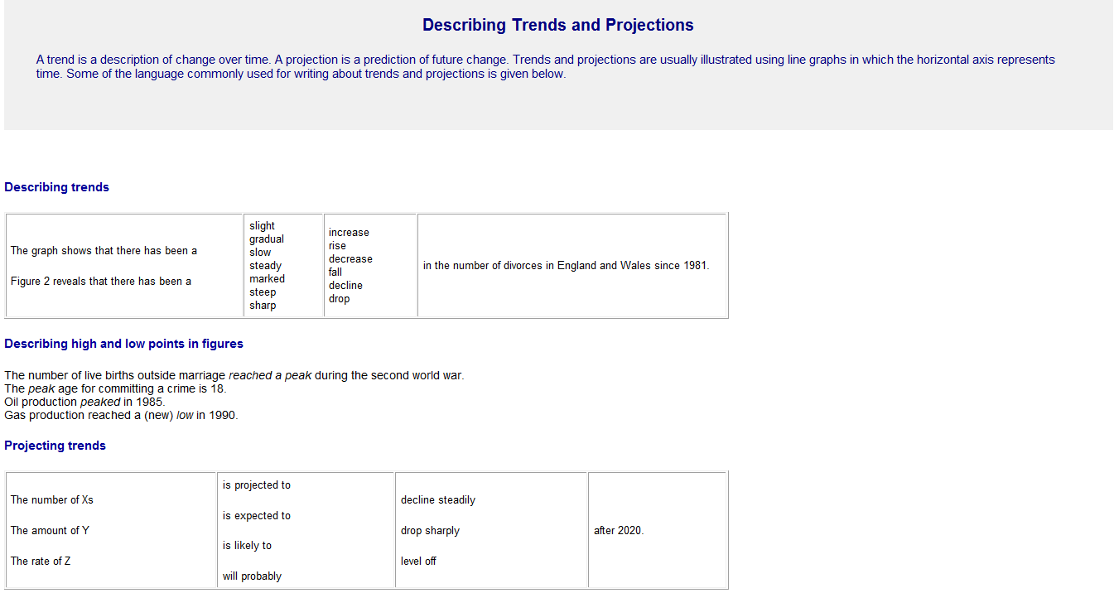

Slide 5
Analysis-
ASSOCIATION
I can see that the association is positive because as x variable name increases the y variable name increases.
Link your relationship back to the context.

Slide 6
Analysis-
RELATIONSHIP
comment on what you can see, use the correlation coefficient to back up your strength statement.
The relationship is strong and linear as I can see most of the points are fairly close to the trend line. This is confirmed by the correlation coefficient of 0.8451, indicating that the linear relationship is quite strong.
r-value | Strength
0.4 - 0.6 | Weak
0.6 – 0.8 | Moderate
0.8 – 1.0 | Strong

Slide 7
Analysis-
SCATTER
how consistent is the scatter? Are there areas that are denser or sparser than others?
The scatter appears to be reasonably consistent throughout the data range with no obvious areas with more points

Slide 8
Analysis-
OUTLIERS
explain why the outlier might be there. Is it . . .
a measurement error
an impossible real life value
incorrectly entered data
If you believe that an outlier is an erroneous value and you can justify this conclusion, you can remove it.
what happens when you remove it and re-plot the graph?
was it an influential point
best plan – point it out, show what happens when you remove it, make a comment then put it back in.

Slide 9
Analysis-
GROUPING
has your data ended up in clusters? Then comment on it!
no clusters? Then comment on it!
Link your comments to what you can see.
Looking at the graph I can not see any obvious grouping.
Looking at the graph I can see there is some evidence of grouping with a bunch less than 0.4 carats, a bunch around 0.55 carats, 0.75 carats and 1 carat. All of these bunches still fit the trend line reasonably closely.

