Slide 1
Multivariate Data
3.10
4 credits
AS91582

Slide 2
Multivariate Data
Learning objectives
recognise each part of the analysis phase

Slide 3
Dot plots and box and whisker plots are produced
summary statistics, including the difference between the sample medians, have been calculated.
sample distributions are discussed and compared in context. This includes seeking explanations for features of the data, which have been identified and considering the impact of these on the context or investigative question. Reference to knowledge from the research needs to be included in the discussion.
A formal statistical inference is made by using resampling (bootstrapping) to construct a confidence interval.

Slide 4
Analysis
Dot plots and box and whisker plots are produced
use inZight

Slide 5
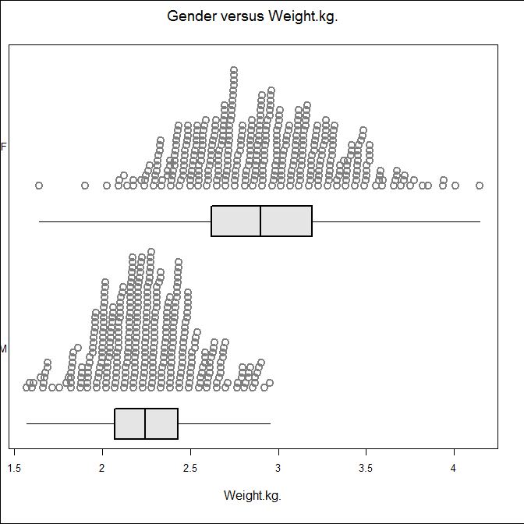
Weight of kiwi birds by Gender
improve the title

Slide 6
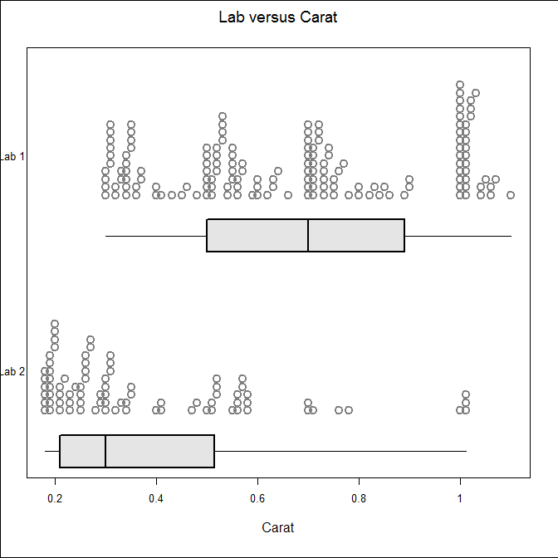
Diamond carat by lab

Slide 7
Box plots are used when comparing data from two different samples because:
extreme values affect the mean much more than the median
analysis focuses on the box rather than the whiskers
an outlier has a minimal effect on the median

Slide 8
Discussing and compare sample distributions in context
Make it clear you are talking about the sample at this stage
talk about
initial visual impressions
shape
Centre
Spread
Shift/overlap
Unusual features ( gaps, outliers)
so where to go to find out about these!
Sigma textbook chapter 6 page 127 6.01, 6.02

Slide 9
And for merit: ‘I notice... I expected ... I was surprised that...’
Also consider possible reasons or causes of these features (in the context) (Merit & Excellence)

Slide 15
”Using graphs to explore differences between two groups”
from statslc fits here along with the quiz on their website

