Slide 1
Trig Identities and Formulae
AS 91575
4 credits

Slide 2
Identically equal
≡

Slide 3
sin(x) ≡ cos(90° - x)
$$\sin\left(x\right)= \frac{o}{h}$$
$$\cos\left(90−x\right)= \frac{o}{h}$$
90 -x
h
o
$$\cos\left(x\right)= \frac{a}{h}$$
$$\sin\left(90−x\right)= \frac{a}{h}$$
x
a
cos(x) ≡ sin(90° - x)

Slide 4
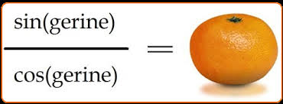
$$\frac{sin⁡(x)}{cos⁡(x)}≡tan⁡(x)$$

Slide 5
sec(x) = $\frac{1}{cos⁡(x)}$
cosec(x) = $\frac{1}{sin⁡(x)}$
$$\cot\left(x\right)= \frac{1}{tan⁡(x)}= \frac{cos⁡(x)}{sin⁡(x)}$$

Slide 6
sin²(x) + cos²(x) ≡ 1
if we divide each term by sin²(x) we get
1 + cot²(x) ≡ cosec²(x)

Slide 7
1 + cot²(x) ≡ cosec²(x)
can be cleverly rearranged to give
cot²(x) ≡ cosec²(x) - 1
cosec²(x) - cot²(x) ≡ 1

Slide 8
1 + cot²(x) ≡ cosec²(x)
cot²(x) ≡ cosec²(x) - 1
cosec²(x) - cot²(x) ≡ 1

Slide 9
sin²(x) + cos²(x) ≡ 1
if we divide each term by cos²(x) we get
tan²(x) + 1 ≡ sec²(x)

Slide 10
tan²(x) + 1 ≡ sec²(x)
can be cleverly rearranged to give
tan²(x) ≡ sec²(x) - 1
sec²(x) - tan²(x) ≡ 1

Slide 11
tan²(x) + 1 ≡ sec²(x)
tan²(x) ≡ sec²(x) - 1
sec²(x) - tan²(x) ≡ 1

Slide 12
use these amazing identities to prove the identities in exercise 6.02 on page 95
remember LHS = RHS

Slide 13
Compound Angle
Formulae
part i

Slide 14
sin(A + B) = sinAcosB + cosAsinB
cos(A + B) = cosAcosB - sinAsinB
tan(A + B) = tanA + tanB 1 - tanAtanB

Slide 15
sin(A - B) = sinAcosB - cosAsinB
cos(A - B) = cosAcosB + sinAsinB
tan(A - B) = tanA - tanB 1 + tanAtanB

Slide 16
cosec(A ± B) = $\frac{1}{sin⁡(A±B)}$
sec(A ± B) = $\frac{1}{cos⁡(A±B)}$
cot(A ± B) = $\frac{1}{tan⁡(A±B)}$

Slide 17
you will now be tested on your ability to recognise these formulae ☺
page 97 exercise 6.03

Slide 18
Compound Angle
Formulae
part ii

Slide 19
Using the compound angle formulae
tan(A) = 1.2 tan(B) = 0.75
calculate tan (A – B)
if sin(α) = $\frac{1}{3}$ sin (β)= ½ find sin(α+ β), given α and β are both acute
(hint draw the triangles first)

Slide 20
you will now be tested on your ability to use these formulae ☺
page 98 exercise 6.04
page 99 exercise 6.05

Slide 21
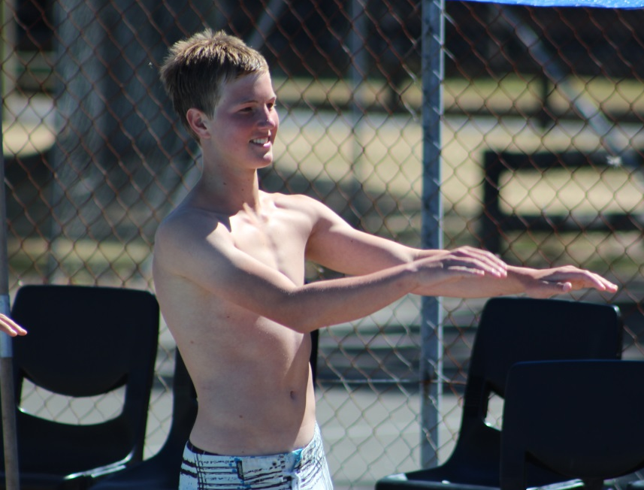
Double Angle
Formulae

Slide 22
Double Angle Formulae
Learning objectives
I can use the double angle formulae to solve problems

Slide 23
sin2A = 2sinAcosA
cos2A = cos²A - sin²A
= 1 - 2sin²A
= 2cos²A - 1

Slide 24
tan2A = 2tanA 1 - tan²A

Slide 25
Using the double-angle formulae
Given tan(θ) = 0.5 calculate tan(2θ)
if sin(α) = $\frac{1}{4}$ and α is an obtuse angle, calculate the value of:
sin (2α)
cos(2α)
(hint draw a diagram to help)

Slide 26
Success Criteria
you will now be tested on your ability to use these formulae ☺
page 100 exercise 6.06
page 101 exercise 6.07
page 102 exercise 6.08

Slide 27
Special triangles

Slide 28
Special Triangles
Learning objectives
I can use the exact values of sin, cos and tan for angles of 30° , 60° and 45° to solve problems

Slide 29
Equilateral Triangle
Q
2
2
P
R
S

Slide 30
 | 30° | 45° | 60°
sin | $$\frac{1}{2}$$ | $$\frac{1}{\sqrt{2}}$$ | $$\frac{\sqrt{3}}{2}$$
cos | $$\frac{\sqrt{3}}{2}$$ | $$\frac{1}{\sqrt{2}}$$ | $$\frac{1}{2}$$
tan | $$\frac{1}{\sqrt{3}}$$ | 1 | $$\frac{1}{\sqrt{3}}$$

Slide 31
Use the trig values from the special triangles to determine the EXACT value of sin(15°)
sin(15) = sin(60 – 45)

Slide 32
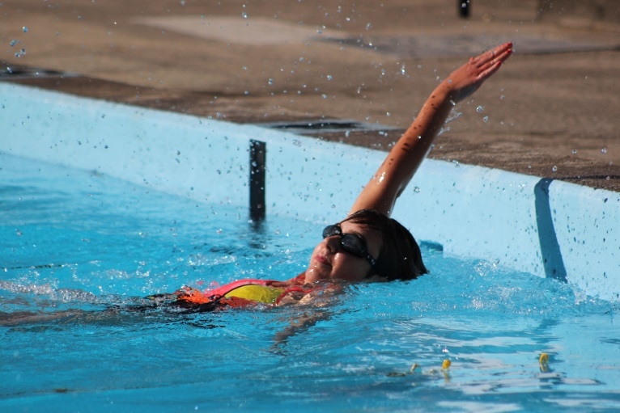
Success Criteria
I can use the exact values of sin, cos and tan for angles of 30° , 60° and 45° to solve problems
page 104 exercise 6.09

Slide 33
Sums and Products

Slide 34
Sums and Products
Learning objectives
I can recognise and use the formulae that change between the product and sum of two trig functions

Slide 36
Success Criteria
I can recognise and use the formulae that change between the product and sum of two trig functions
page 106 exercise 6.10
page 108 exercise 6.11

