Slide 1
Systems of equations
Internal assessment
3.15

Slide 2
Systems of linear equations
Learning objectives
I can identify the three types of solution for linear equations (unique, inconsistent, dependent)

Slide 4
Systems with no unique solutions
The geometric interpretation of this:
There are lots of words round this so
Equations are inconsistent means there are no points on all three planes.
Three parallel planes modelled by Ethan, Bara and Jonny
Each plane is parallel to the intersection of the other two planes (makes a triangular prism)
Two parallel planes and the other one cuts through them both
2. Equations are dependent means there is an infinite number of points on all three planes
the planes of the consecutive pages of a book all intersect along the spine.

Slide 5
Systems with no unique solutions
The algebraic interpretation of this:
Equations are inconsistent means one equation will contradict the others
3x – y + z = 4
x + 5y -3z =23
2x +2y – z = 18
make y the subject of 1 and substitute into 2 and 3
solve these 2 equations in x and z
0 = -9
this contradiction means there is no solution, no numbers satisfy all 3 equations. The equations are inconsistent.

Slide 6
An infinite number of solutions means the equations are dependent. One of the agrees completely with the other and no new information is given.
(pages in the book)
4x – y + 2z = 5
x + 3y - 5z =4
6x +5y – 8z = 13
make x the subject of 2 and substitute into 1 and 3
solve these 2 equations in x and z
0 = 0
this contradiction means there are multiple solutions.

Slide 7
demonstrate that the following system of equation has no unique answer. Find some of the answers.
x + 2y + z = -9 (1)
x + y -4z = 33 (2)
-2x -3y +3z = -24 (3)
(2) x -1 = (4)
+ (4) = (5)
x 2 = (6)
(6) + (3) = (7)
combining (5) and (7) should give 0 = 0
therefore there are no unique solutions, the equations are dependant.

Slide 8
demonstrate that the following system of equation has no unique answer. Find some of the answers.
x + 2y + z = -9 (1)
x + y -4z = 33 (2)
-2x -3y +3z = -24 (3)
assume the answer for z is t
form two equations y = -42 -5t
x = 75 + 9t
when t = 0 z = 0, x = 75 and y = -42
when t = -8 z = -7, x = 3 and y = -2

Slide 9
find the value of k which means that these simultaneous equations do NOT have a unique answer.
3x + 2y – z = 3 (1)
2x – 3y + 2z = 21 (2)
-7x – 9y +5z = k (3)
start by eliminating y, from (1) and (2) we should get
13x + z = 51 (6)
now eliminate y from (2) and (3) we should get
-13x – z = -63 + k (8)
recognise (6) and (8) are parallel lines so
-63 + k + 51 = 0
0 = k – 12
if k = 12 ( 0 = 0) we do not have a unique solution
if k ≠ 12 ( eg 0 = 21) there are no solutions

Slide 10
Too many equations (or variables)
3a – 7b + 4c – d = 14
2a + b -5c +d = 2
a – b + 2c – 2d = 0
4 unknowns need 4 equations before you can solve it!
on the other hand you may have 4 equations in 3 unknowns, in this case the equations may be:
dependent on each other
inconsistent - if there is a solution for the first n equations it will not satisfy the remaining equation(s)

Slide 11
Example of a dependent set of equations
x – 4y = 9
x + y = -1
2x + 7y = -12
solve the first 2 equations to get x = 1 y = -2
these values satisfy the third equation!

Slide 12
Example of a inconsistent set of equations
x + 5y = 6
3x – y = 2
4x + y = 19
solve the first 2 equations to get x = 1 y = 1
these values DO NOT satisfy the third equation!
solve equations 2 and 3 to get x = 3 y = 7
these values DO NOT satisfy the first equation!
graphically this is three lines crossing at different points (triangle shape)

Slide 15
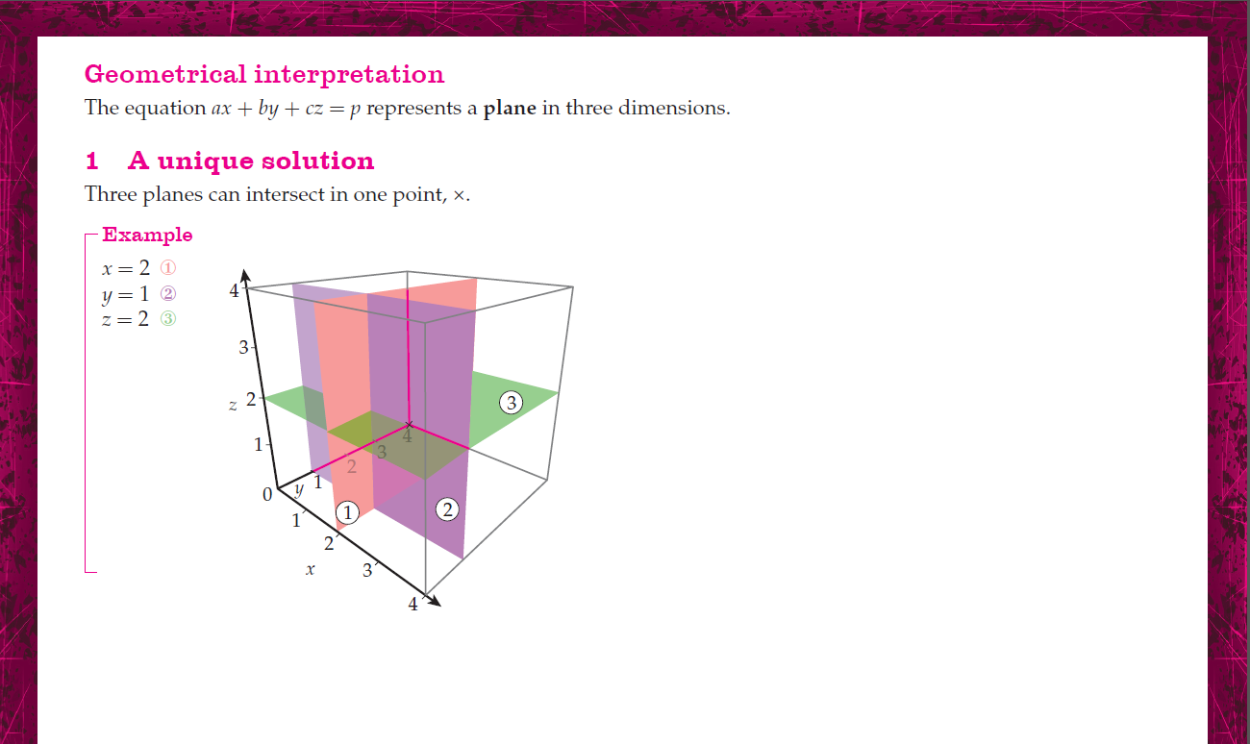

Slide 19
Success Criteria
I can identify the three types of solution for linear equations (unique, inconsistent, dependent)

