Slide 1
Trig Graphs and reciprocal trig functions
AS 91575
4 credits

Slide 2
Graphs of
Trigonometric Functions
Learning objectives
I know recognise the graphs for sin, cos and tan
I am familiar with the words domain, range, odd function, even function, amplitude and period
I can transform graphs of trigonometric functions

Slide 3
Keywords
Domain: the possible x values of a function
Range: the possible y values produced by a function
Period: the regular interval a graph repeats itself over
amplitude: the height of the graph

Slide 4
Let P be a point with coordinates (x, y) on the circle with centre at the origin and radius 1.
y
Let angle PON be
P (x, y)
Then,
y
x
O
N

Slide 5
e.g.
y
y
1
y
x
20
40
60
80

Slide 6
e.g.
y
y
1
y
x
20
40
60
80

Slide 7
e.g.
y
y
1
y
x
20
40
60
80

Slide 8
e.g.
y
y
1
y
x
20
40
60
80

Slide 9
e.g.
y
y
1
y
x
20
40
60
80

Slide 10
Also, when
y
y
x
1
x
x
x
x
x
x
20
40
60
80

Slide 11
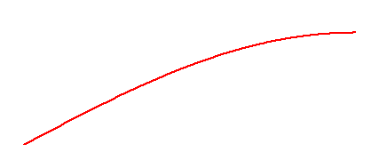
y
y
1
x
x
x
x
x
x
x
20
40
60
80

Slide 12
y
1
10
20
30
40
50
60
70
80
As increases from to , y increases from 0 to 1.

Slide 13
We have, so far, only defined for angles between and .
We will now extend the definitions for an angle which can be any size and may be positive or negative.

Slide 14
Suppose , then
y
y
x

Slide 15
e.g. suppose , then
y
x

Slide 16
If , . . .
y
y
x

Slide 17
If , . . .
y
. . . then y is still
y
x
But
So,

Slide 18
The quarter of the circle where the angles are between and is called the 1st quadrant.
For each angle in the 1st quadrant there is an angle of in the 2nd quadrant where

Slide 19
e.g.
y
x
Notice the symmetry about the y-axis .

Slide 20
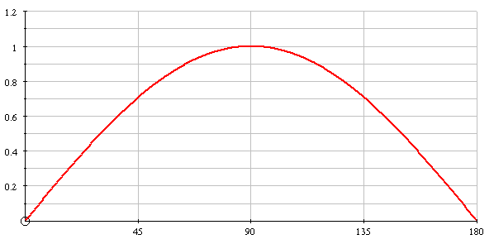
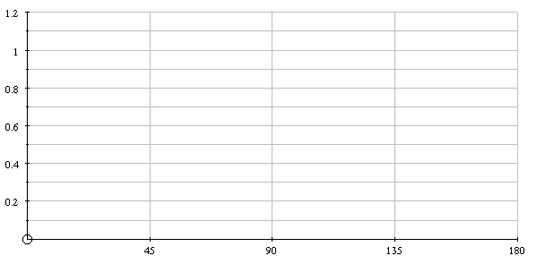
The symmetry about enables us to draw the graph for between and .
x
x
e.g.

Slide 21
The symmetry about enables us to draw the graph for between and .
x
x
e.g.

Slide 22
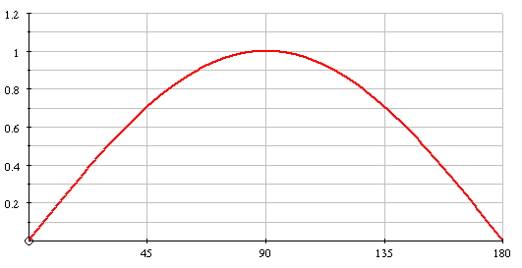
The graph of between and is

Slide 23
For angles between and ( the 3rd and 4th quadrants ), the y coordinates are negative.
y
e.g.
So,
x

Slide 24
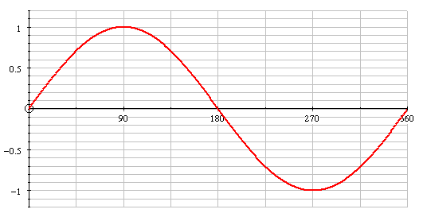
The sine of each angle between and has the same magnitude as an angle between and BUT is negative. The graph for is:

Slide 25
For angles larger than we continue round the circle, so the values of repeat every .
y
e.g.
x

Slide 26
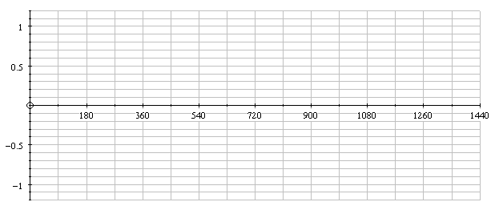
We can extend the graph as shown

Slide 27
We can extend the graph as shown

Slide 28
Negative angles are defined as those formed by turning in a clockwise direction from .
e.g.
y
So,
x

Slide 29
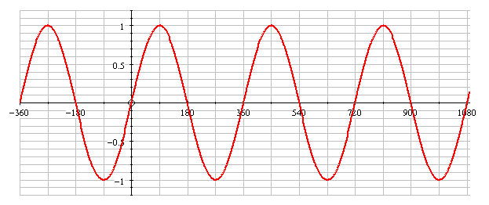
We can now draw the graph of for any interval. e.g.
If you have a graphical calculator, this graph will be one of the standard graphs BUT make sure you can also sketch it without your calculator !

Slide 30
SUMMARY
The trig function is defined for any angle.
The graph of repeats every .
The minimum value of is and the maximum is .
The graph for
is . . .
. . . and must be memorised.

Slide 31
y = sin(x)
Domain: $x ∈ℝ$
Range: -1 ≤ y ≤ 1
Period: 2$π$
odd function and the graph has point symmetry (half turn rotational symmetry about the origin). Rotation is associated with odd functions.

Slide 32
y = cos (x)
Domain: $x ∈ℝ$
Range: -1 ≤ y ≤ 1
Period: 2$π$
even function and the graph has the y-axis as an axis of symmetry. Reflection is associated with even functions

Slide 33
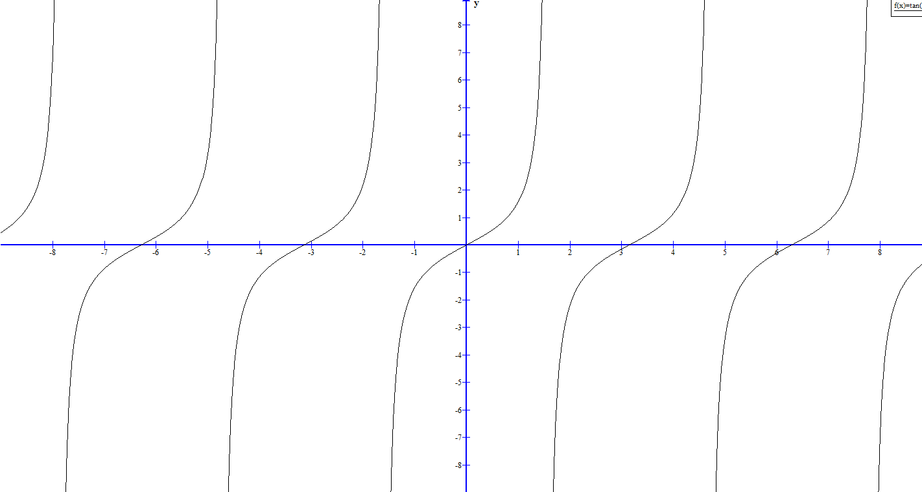
y = tan(x)
Domain:
Range:
Period:
odd function. The graph has point symmetry (half turn rotational symmetry about the origin)

Slide 38
all in one go the equation this looks like
y = Asin(Bx+c) + D
A amplitude
B $\frac{2π}{Period}$
C horizontal translation
D vertical translation

Slide 39
originally this was sin(x)
what is it now?
new period?

Slide 40
y = sin(5x)

Slide 41
y = 5sin(x)

Slide 42
y = 2cos(2x)

Slide 43
y = 2cos(x) + 3

Slide 44
y = 2sin(0.5x)

