Slide 1
Trig Graphs and reciprocal trig functions
AS 91575
4 credits

Slide 2
Radian measure
Learning objectives
I know what a radian is
I can convert between radians and degrees

Slide 3
We can use the same scale on the x and the y axis and they are both in numbers.
if we did this with the x axis in degrees, the graph would be well stretched out and the x axis is not really in numbers.

Slide 4
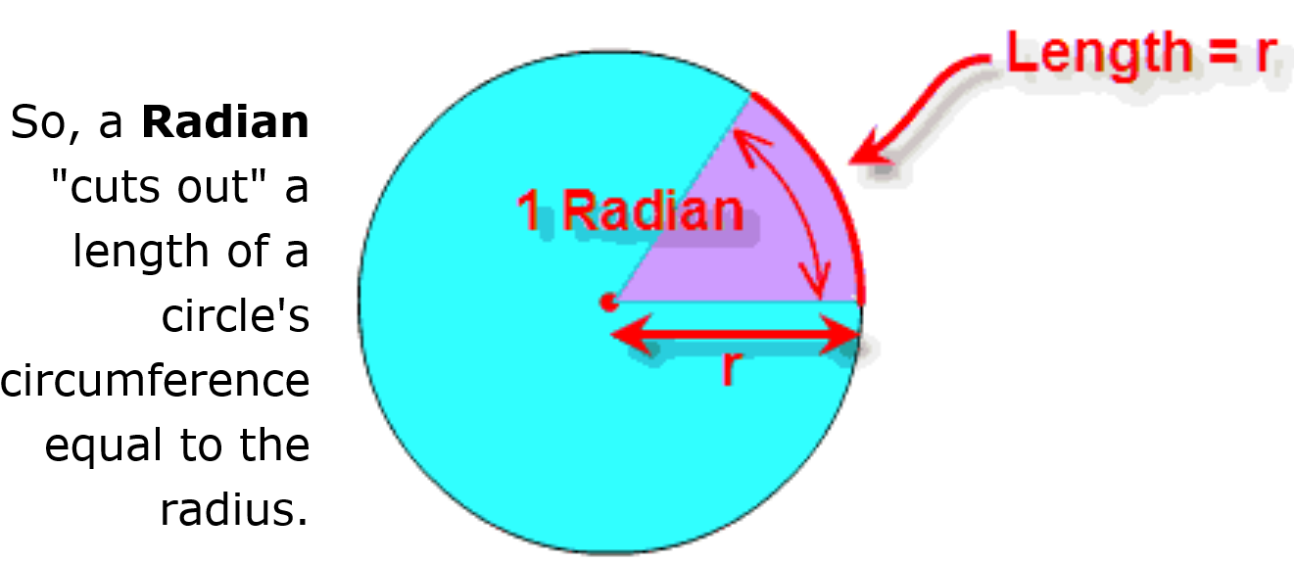
What is a radian?

Slide 5
The second most thrilling experience in the universe is to be able to convert between radians and degrees
to convert degrees to radians multiply by $\frac{π}{180}$
to convert radians to degrees multiply by $\frac{180}{π}$
this is because
the total arc length is the circumference of the circle = $2πr$
but arc length = θr where θ is the angle of the arc
θ = 2$π$ = 360°

Slide 7
to convert degrees to radians multiply by $\frac{π}{180}$
Convert 60° to radians. Leave you answer in terms of $π.$
to convert radians to degrees multiply by $\frac{180}{π}$
Convert $\frac{3π}{4}$radians to degrees

Slide 8
