Slide 1
All Change
It Fits
Tessellations
To be able to:
Draw tessellations level 4
Skills I need:

Slide 2
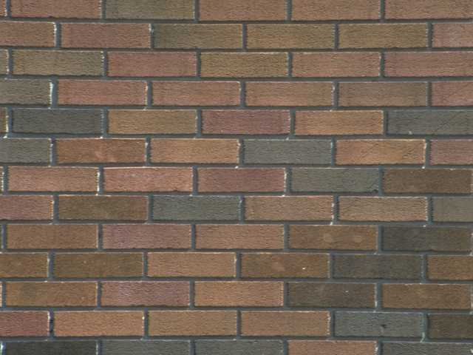
Tessellations
A tessellation is a repeating pattern that tiles the plane without leaving any gaps.
A regular tessellation is made from a single regular polygon.
4
5
3
Equilateral Triangle
Square
Regular Pentagon
Which of these will tile the plane?
6
8
Regular Hexagon
Regular Octagon

Slide 3
Equilateral Triangles:
Do tessellate ✓

Slide 4
Squares:
Do tessellate ✓

Slide 5
Regular Pentagons:
Don’t tessellate
They make a nice ring.

Slide 6
Regular Hexagons:
Do tessellate ✓

Slide 7
This is called a semi-regular tessellation since more than one regular polygon is used.
Regular Octagons:
Don’t tessellate:
But they make a great kitchen floor when put with squares.

Slide 8
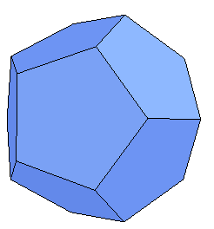
There are only 3 regular tessellations. Can you see why?
60º
120º
60º
60º
90º
90º
60º
90º
90º
120º
60º
60º
120º
6 x 60º = 360º
4 x 90º = 360º
3 x 120º = 360º
108º
108º
135º
135º
36º
108º
90º
3 x 108º = 324º
2 x 135º = 270º
Consider the sum of the interior angles about the indicated point.

Slide 9
Interactive
There are 8 distinct semi-regular tessellations.
The tiles for 4 of them are shown below.

Slide 14
Non-Regular tessellations.
Other shapes such as rectangles will tessellate.

Slide 15
In fact any quadrilateral will tessellate.

Slide 16
Drawing Tessellations
Show that the kite tessellates. Draw at least 6 more on the grid

Slide 17
Drawing tessellations
Show that the hexagon tessellates. Draw at least 6 more on the grid

Slide 18
Drawing tessellations
Show that the trapezium tessellates. Draw at least 8 more on the grid

Slide 19
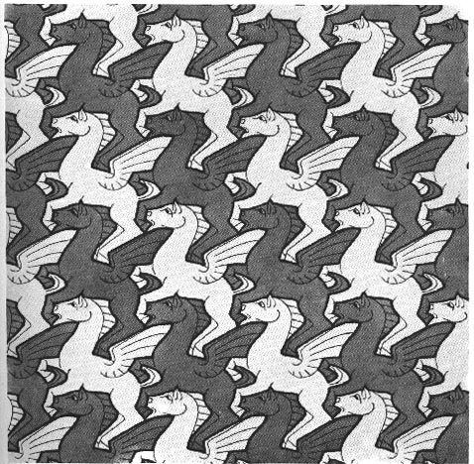

Slide 20
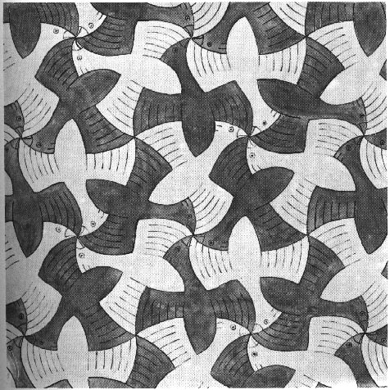

Slide 23
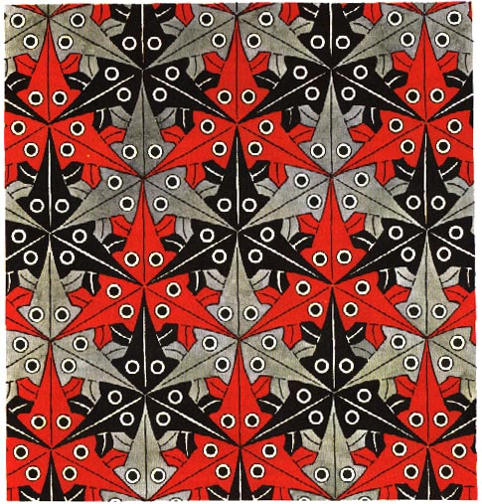

Slide 24
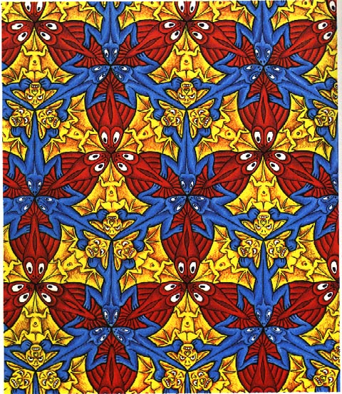

Slide 25
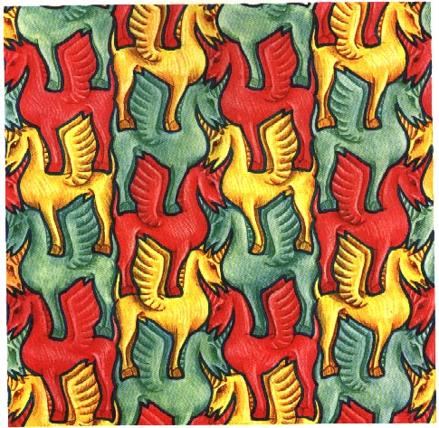

Slide 28
Your Turn
MEP resource sheet – tessellate at least 10 of each shape
or
Draw your own template and tessellate that

Slide 29
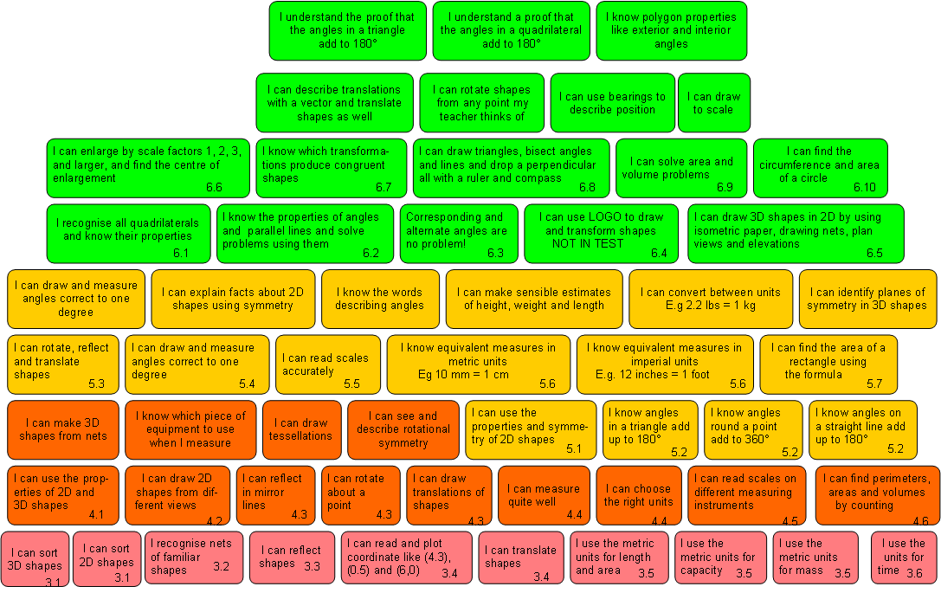
Shape, and Space Wall Level 3 - 6

Slide 30
Extend yourself
Investigate the work of M C Esher

