Slide 1
Systems of equations
Internal assessment
3.15

Slide 2
Systems of linear equations
Learning objectives
I can solve linear simultaneous equations by calculator
I understand the different types of solution that might arise
I can solve 3 equations by substitution or elimination

Slide 3
Solving two equations on your calculator
Select Equations, Simultaneous and two unknowns (8, F1, 2)
Make sure your equations are in the form ax + by = c
Enter the variables and press F1 for your solution.
Do the same for three equations
The problem starts if there are not unique solutions to the equations.

Slide 4
Two equations
Lines intersect | Lines are parallel | Lines are the same
Unique solution | No solution | Many solutions
 | Equations are Inconsistent | Equations are Dependent

Slide 5
Three equations
planes intersect | planes are parallel | Lines are the same
Unique solution | No solution | Many solutions
 | Equations are Inconsistent | Equations are Dependent
Trying the second two on the calculator gives a MA ERROR message ☺

Slide 6
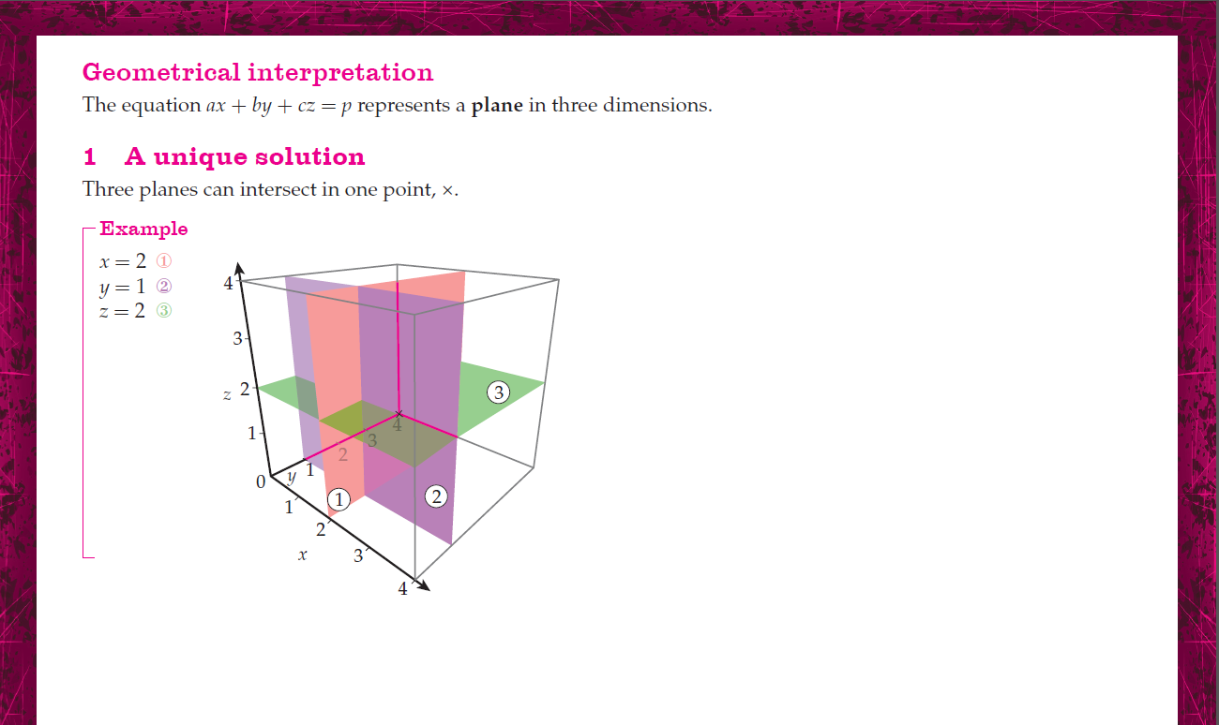

Slide 10
Solution by elimination
x – 2y + z = 0
2x + 2y + 3z = 7
-3x + 8y + 2z = -7
label each equation
eliminate x from 2 and 3
don’t forget to renumber the equations
use your calculator to check your method gave you the right answers

Slide 11
achievement
Now try these:
x + y + 2z = 6
3x + 2y + 4z = 9
-2x + 3y – 6z = 3
f + g = 7
f + 2g + 4h = 17
2h – 3f – g = -22
x + 3y + z = -1
2x – y – z = 7
3x – 2y + 2z = 0
a + 2b – 3c = 5
a – 2b + 5c = 5
5a – 11b + 2c = 5
y = 2x + z – 7
y = 8 – 4x – 2z
4x + 2y + 5z = 3
p = 2q + r + 1
q = p – 4r – 1
r = 3q - p

Slide 12
Solution by substitution
x = 5 + y
x + y + z = 7
z = y + 1 - x
label each equation
using 1 substitute for x in 2 and 3
don’t forget to renumber the equations
use your calculator to check your method gave you the right answers

Slide 13
achievement
now try these:
3x + y + z = 2
x = y + z
5x + 4y + z = 2
7x + 3y + 2z +5 = 0
2x – 5y + 3z = 3
x = y - z
3x + 6y = 3
6x – 2y + z = 19
z = 4 + x
$\frac{x}{3}+ \frac{y}{4}+ \frac{z}{5}=6$
x – z = y
$\frac{x}{6}= \frac{z}{10}$
y = 2x + 2z + 1
4x + 2y + 6z = 10
2x = 1 + 2y + z
3.14x + 1.67y = 5.76
2.76x – 1.75y + 3.65z = 3.89
4.17x – 5.87z = -1.23

Slide 14
Success Criteria
I can solve linear simultaneous equations by calculator
I understand the different types of solution that might arise
I can solve 3 equations by substitution or elimination

