Slide 2
Geometry
Three Dimensions

Slide 3
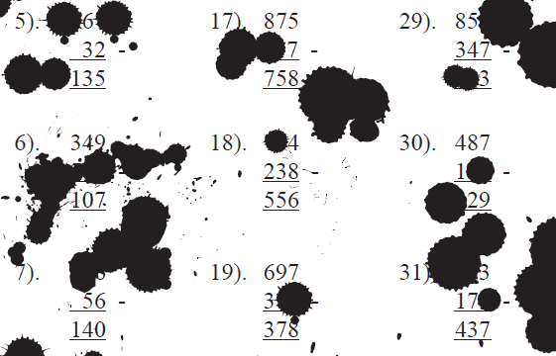
Maddison came with some twink and filled in all the missing numbers. What did the sums look like then?
No calculators

Slide 4
Three Dimensions
Learning objectives
I can draw shapes on isometric paper

Slide 5


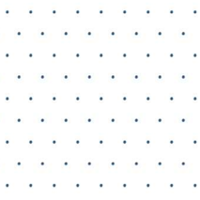
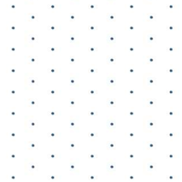
Drawing 3-D shapes on an isometric grid
The dots in an isometric grid form equilateral triangles when joined together.
When drawing an 2-D representation of a 3-D shape make sure that the grid is turned the right way round.
The dots should form clear vertical lines.

Slide 6

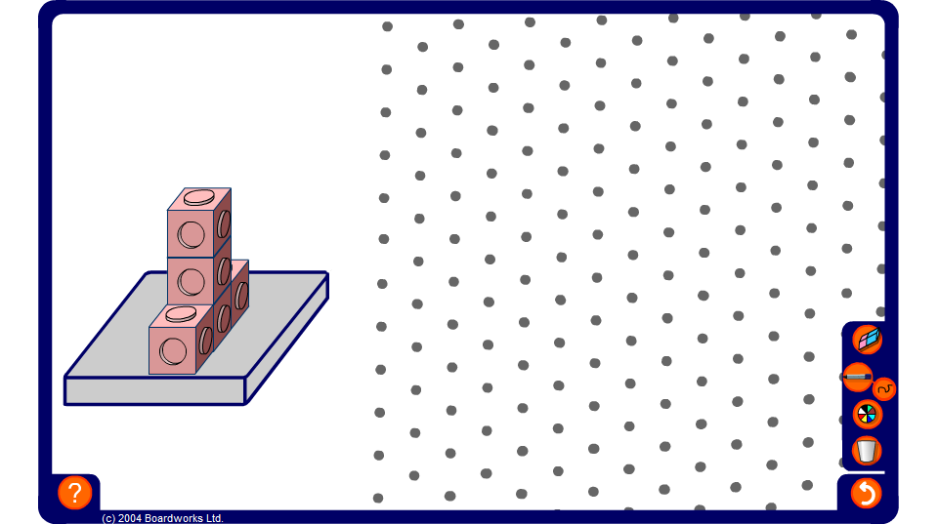
Drawing 3-D shapes on an isometric grid
Notes:
Use this activity to practice and to demonstrate isometric drawings of 3-dimensional shapes made from cubes.
Use the pen tool, set to draw straight lines, to draw the required shape on the grid.
As a more challenging exercise ask pupils to draw the given shape in different orientations of with extra cubes added in given positions.

Slide 7
2-D representations of 3-D objects
There are several different ways of drawing the same shape.
Are these all of the possibilities?
Can you draw the shape in a different way that is not shown here?
How many different ways are there?
Notes:
You may wish to have a model of this shape made of interconnecting cubes in class. You can invite pupils to think logically about all of the different possible orientations there are and use the model to demonstrate these.
Challenge pupils to draw these on isometric paper.

Slide 8
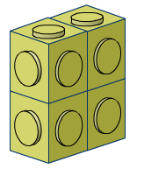
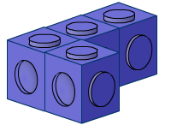
Making houses with four cubes
How many different houses can you make with four interlocking cubes?
Make as many houses as you can from four cubes and draw each of them on isometric paper.
Notes:
Challenge pupils to find all of the solids that can be made from four cubes. The solution is shown on the next slide. Pupils may use real cubes if they need to, but should record their results as drawings on isometric paper.
Point out that when we say ‘different’ shapes, we do not include rotations and reflections of the same shape.
Suggest to pupils that if they work systematically, they can be more certain of finding all the shapes. For example, there are only two different shapes that can be made from three cubes. Pupils could start with one of their two shapes and make shapes from four cubes by moving a single cube to different positions. They should draw each one ignoring reflections and rotations of the same shape.
These shapes are called tetracubes.

Slide 9
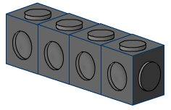
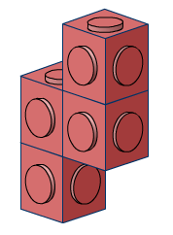
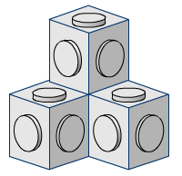
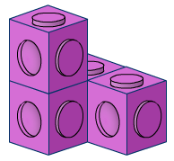
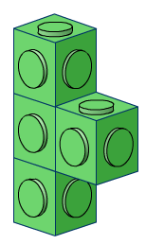
Making houses with four cubes
You should have seven shapes altogether, as follows:
Notes:
Pupils can compare their answers with these pictures. They should be able to match shapes that they have drawn in a different orientation.

Slide 10
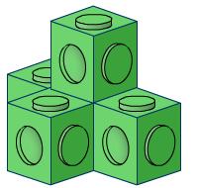
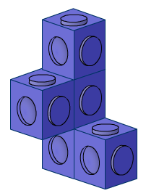
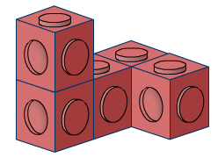
Making houses from five cubes
Investigate the number of different houses you can make with five interlocking cubes.
Make as many as you can and draw each of them on isometric paper.
Notes:
Extend the activity to five cubes.
Pupils could start by finding all of the shapes that are made up of a single layer. There are 12 of these, called pentominos.
Pupils can then move on to using more layers to make pentacubes. There are 11 shapes made from more than one layer, not including rotations and reflections.
If reflections are allowed, there are 29 possible shapes altogether (not including reflections there are 23).

Slide 11
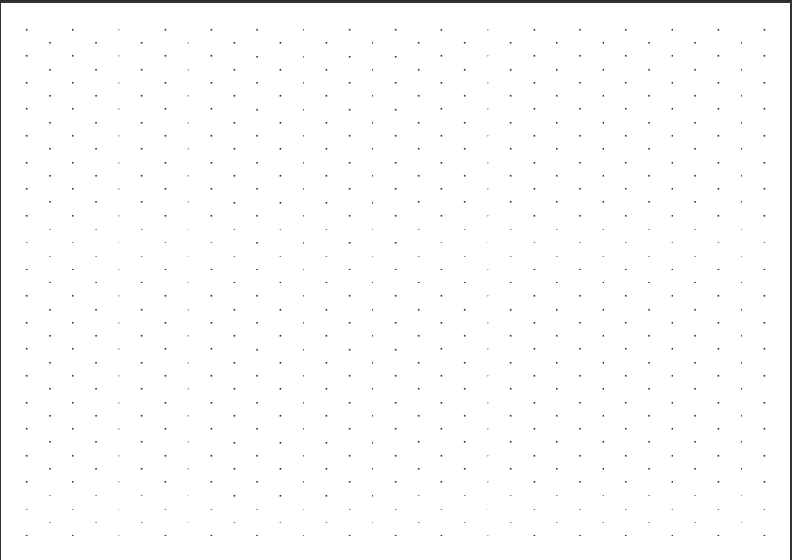
Show me what you did

Slide 12


Success Criteria
I can draw shapes on isometric paper
all the 4 cube houses
10 Ticks level 6 pack 3 pages 37 - 38

