Slide 1
1.11 Bivariate Data
Credits 3
As91036

Slide 2
Achieved, Merit or Excellence

Slide 3
Achievement
You need to use investigate bivariate numerical data using the statistical enquiry cycle. (See Statistics revision).
Numerical data:
the x variable or explanatory variable may be a continuous or discrete numerical variable, eg the different lengths set for a pendulum in an experiment, or the number of books in a back-pack in a survey
the y-variable or response variable must be a numerical variable where the numbers measure the quantity of interest.
Make sure that you are familiar with the statistical enquiry cycle which involves:
planning and conducting an investigation involving bivariate numerical data
working with a given relationship question
determining appropriate variables and measures
managing sources of variation
gathering data
selecting and using appropriate display(s)
communicating relationship(s) in the data in a conclusion.

Slide 4
Achievement with merit
Make sure that you can meet the criteria for achievement
You need to investigate bivariate numerical data using the statistical enquiry cycle with justification.
This involves linking aspects of the statistical enquiry cycle to the context and the population. Justification also involves making supporting statements which refer to evidence such as summary statistics, data values, trends or features of visual displays.

Slide 5
Achievement with excellence
Make sure that you can meet the criteria for merit
You need investigate bivariate numerical data using the statistical enquiry cycle with statistical insight.
This means integrating statistical and contextual knowledge throughout the statistical enquiry, reflecting about the process and may involve considering other explanations.

Slide 6
What we need to study

Slide 7
Statistics Revision
Bitesize revision – Statistics
Displaying data
Line of best fit
Regents Prep: Scatter plots and line of best fit
Interactive: Scatter Plot and line of best fit
Onlinemathlearning: Scatter plot and the line of best fit
Graphing and interpreting bivariate data
Statistical Enquiry Cycle
How kids learn – the statistical enquiry cycle
CensusAtSchool

Slide 8
Summary Statistics
Learning objectives
I can find summary statistics

Slide 9
Using your calculator to find summary statistics.
Select 2 from the menu to get STAT.
Delete any existing data by pressing F6 F4 F1 {(more) DEL_A YES] and repeat if required
Move the cursor to column one and enter the data values.
12, 15, 21, 14, 13, 12, 11, 24, 19, 17, 18, 17, 21, 12,
Select F2 F6 (CALC, SET) and check that 1Var Xlist: list1 and 1Var Freq: 1
Then press EXE F1
Scrolling down what summary statistics have you been given?

Slide 10
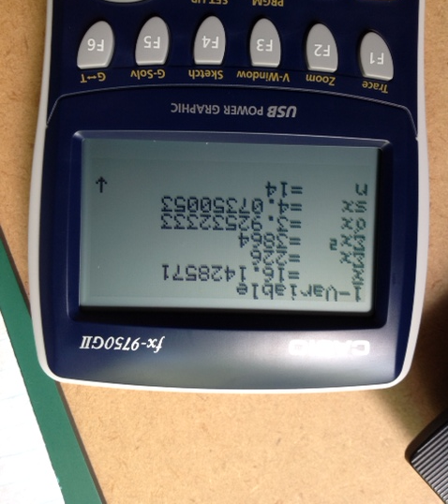

Slide 11
Using your calculator to find summary statistics from a frequency table.
Select 2 from the menu to get STAT.
Delete any existing data by pressing F6 F4 F1 {(more) DEL_A YES] and repeat if required
Move the cursor to column one and enter the data values for Bullseyes.
Bullseyes | frequency
0 | 2
1 | 3
2 | 4
3 | 7
4 | 6
5 | 3
total | 35

Slide 12
Using your calculator to find summary statistics from a frequency table.
Move the cursor to column two and enter the frequency.
Select F2 F6 (CALC, SET) and check that 1Var Xlist: list1 and 1Var Freq: 1
Then press EXE F1
Scrolling down what summary statistics have you been given?
Bullseyes | frequency
0 | 2
1 | 3
2 | 4
3 | 7
4 | 6
5 | 3
total | 35

Slide 13
Using your calculator to find summary statistics from a frequency table.
Bullseyes | frequency
0 | 2
1 | 3
2 | 4
3 | 7
4 | 6
5 | 3
total | 35
Select F2 F6 (CALC, SET) and check that 1Var Xlist: list1 and 1Var Freq: list2
Then press EXE F1
Scrolling down what summary statistics have you been given?

Slide 14
Success Criteria
I can find summary statistics
Nulake questions 1, 4, 7, 10 find mean, mode, median
18, 21, 24, 27 LQ, UQ median
our data find mean, median, mode, LQ, UQ
30, 32, 33, 35, 38 using a frequency table
39 – 45 using a grouped frequency table

Slide 15
The Statistical Enquiry Cycle
how to write a report

Slide 16
Make sure that you are familiar with the statistical enquiry cycle which involves:
planning and conducting an investigation involving bivariate numerical data
working with a given relationship question
determining appropriate variables and measures
managing sources of variation
gathering data
selecting and using appropriate display(s)
communicating relationship(s) in the data in a conclusion.

Slide 17
P
P
D
A
C
roblem
why did I choose to look at this problem
what do I want to find out
what data do I need to collect
who am I collecting my data from (and why)
how large should my sample be
how am I going to analyse my data
lan
Collect
Clean
display (iNZight)
ata
summary statistics
trend line
prediction
association - strong/moderate/weak correlation
scatter evenly distributed along the trend line?
outliers
grouping does the data form clusters anywhere?
nalysis
onclusion
Answer the question you set at the beginning
refer back to your results
suggest how you might improve or extend your investigation

Slide 18
P
roblem
why did I choose to look at this problem
what do I want to find out
why
I have been given . . . . . . . . . and am interested in looking at whether there is a connection between . . . . . . . . and . . . . . . . .
I have been looking at . . . . . . . . . . . and am interested in finding out if there is a connection between . . . . . . . . . . and . . . . . . . . .
what
I wonder if there is a relationship between _________________ and ___________.

Slide 19
P
lan
what data do I need to collect
should I collect primary data or use secondary data?
who am I collecting my data from (and why)
how large should my sample be
how am I taking my sample (sampling techniques)
how am I going to analyse my data

Slide 20
D
ata
Collect – fair and consistent
Clean – justify any data you remove
display (iNZight)

Slide 21
A
nalyse
summary statistics
trend line - also known as regression lines
prediction
association - strong/moderate/weak correlation
scatter evenly distributed along the trend line?
outliers
grouping does the data form clusters anywhere?

Slide 22
C
onclusion
Answer the question you set at the beginning
refer back to your results
suggest how you might improve or extend your investigation
from my analysis I have found that . . . . . . . .
To improve my investigation I could . . . . . . . . .
To extend my investigation I could

